Slide 1
Structured Parallel Programming with Patterns SC13 Tutorial Sunday, November 17th 8:30am to 5pm
Michael Hebenstreit
James R. Reinders
Arch Robison
Michael McCool
Notes:
Abstract: Parallel programming is important for performance, and developers need a comprehensive set of strategies and technologies for tackling it. This tutorial is intended for C++ programmers who want to better grasp how to envision, describe and write efficient parallel algorithms at the single shared-memory node level. This tutorial will present a set of algorithmic patterns for parallel programming. Patterns describe best known methods for solving recurring design problems. Algorithmic patterns in particular are the building blocks of algorithms. Using these patterns to develop parallel algorithms will lead to better structured, more scalable, and more maintainable programs. This course will discuss when and where to use a core set of parallel patterns, how to best implement them, and how to analyze the performance of algorithms built using them. Patterns to be presented include map, reduce, scan, pipeline, fork-joint, stencil, tiling, and recurrence. Each pattern will be demonstrated using working code in one or more of Cilk Plus, Threading Building Blocks, OpenMP, or OpenCL. Attendees also will have the opportunity to test the provided examples themselves on an HPC cluster for the time of the SC13 conference.

Slide 2
Course Outline
Introduction
Motivation and goals
Patterns of serial and parallel computation
Background
Machine model
Complexity, work-span
Intel® Cilk™ Plus and Intel® Threading Building Blocks (Intel® TBB)
Programming models
Examples

Slide 3

Text
Structured Parallel Programming: Patterns for Efficient Computation
Michael McCool
Arch Robison
James Reinders
Uses Cilk Plus and TBB as primary frameworks for examples.
Appendices concisely summarize Cilk Plus and TBB.
www.parallelbook.com

Slide 4
Introduction

Slide 5
Introduction: Outline
Evolution of Hardware to Parallelism
Software Engineering Considerations
Structured Programming with Patterns
Parallel Programming Models
Simple Example: Dot Product
5

Slide 6
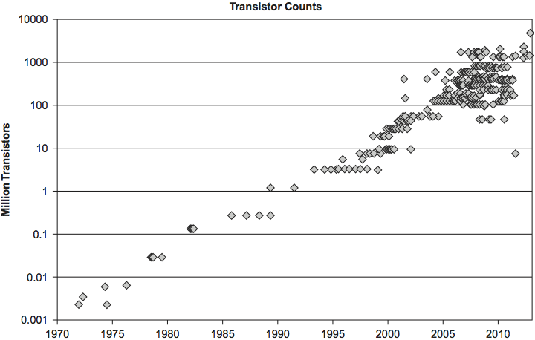
Transistors per Processor over Time Continues to grow exponentially (Moore’s Law)

Slide 7
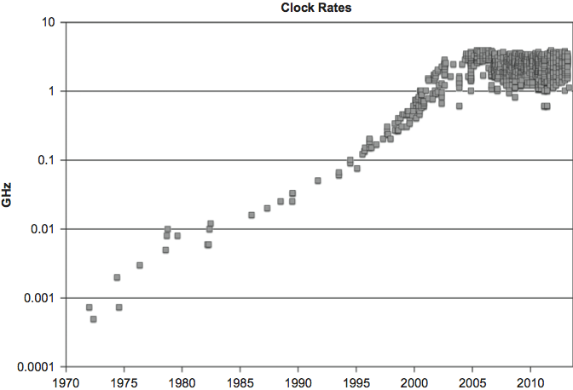
Processor Clock Rate over Time Growth halted around 2005

Slide 8
Hardware Evolution
There are limits to “automatic” improvement of scalar performance:
The Power Wall: Clock frequency cannot be increased without exceeding air cooling.
The Memory Wall: Access to data is a limiting factor.
The ILP Wall: All the existing instruction-level parallelism (ILP) is already being used.
→ Conclusion: Explicit parallel mechanisms and explicit parallel programming are required for performance scaling.
8

Slide 9
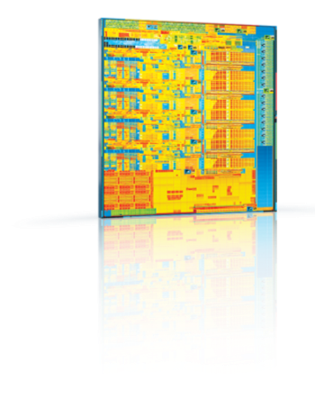
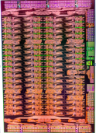
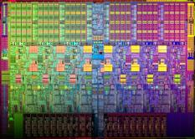
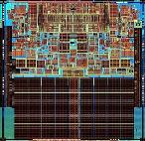
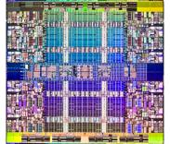
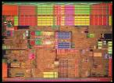
Trends: More cores. Wider vectors. Coprocessors.
Images do not reflect actual die sizes
 | Intel® Xeon® processor 64-bit | Intel® Xeon® processor 5100 series | Intel® Xeon® processor 5500 series | Intel® Xeon® processor 5600 series | Intel® Xeon® processor code-named Sandy Bridge | Intel® Xeon® processor code-named Ivy Bridge | Intel® Xeon® processor code-named Haswell |  | Intel® Xeon Phi™ coprocessor code-named Knights Corner
Core(s) | 1 | 2 | 4 | 6 | 8 |  |  |  | 57-61
Threads | 2 | 2 | 8 | 12 | 16 |  |  |  | 228-244
SIMD Width | 128 | 128 | 128 | 128 | 256 | 256 | 256 |  | 512
 | SSE2 | SSSE3 | SSE4.2 | SSE4.2 | AVX | AVX | AVX2 FMA3 |  | IMCI
Software challenge: Develop scalable software
Intel® Many Integrated Core (Intel® MIC) Architecture
Notes:
Parallelism is a major hardware trend. We can see that in increased core counts and threads, wider vectors and an increasing vector instruction set, and in the addition of highly parallel co-processors.
(Not all the cells are filled in on this chart, some of the information is unreleased, but it won’t be changing the trend.)
The challenge for software developers is: “How do I take advantage of the new hardware without going crazy?”
------------------------------------------------------------------------------------------------------------------------------
Background information:
As developers begin to embrace high degrees of parallelism, Intel offers a parallel architecture that builds on well understood programming models. As a result, programmers can construct algorithms for the CPU and extend them to Intel MIC architecture without rethinking their entire problem. The same techniques that deliver optimal performance on Intel CPUs … scaling applications to cores and threads, blocking data for hierarchical memory and caches, and effective use of SIMD also apply to maximizing performance on Intel MIC
Intel MIC architecture is a logical extension of the Intel CPU – the benefit is greater reuse of parallel CPU code on MIC which leads to the additional benefits of greater programmer productivity, shorter coding time, and shorter time to performance.
---
Intel 2013 Haswell CPUs get AVX2
By Hilbert Hagedoorn, June 14, 2011 - 8:40 PM N/A
http://www.guru3d.com/news/intel-2013-haswell-cpus-get-avx2/
Intel has confirmed that its upcoming Haswell CPU architecture will support the AVX2 instruction set which is designed to improve processor performance in integer-heavy computational applications. Intel has also posted a document online, called Advanced Vector Extensions Programming Reference, which explains the new instruction set.
“AVX2 extends Intel AVX by promoting most of the 128-bit SIMD integer instructions with 256-bit numeric processing capabilities. AVX2 instructions follow the same programming model as AVX instructions.”
“In addition, AVX2 provide enhanced functionalities for broadcast/permute operations on data elements, vector shift instructions with variable-shift count per data element, and instructions to fetch non-contiguous data elements from memory,” reads the document.
Outside of AVX2, Haswell will also include a hardware RNG (random number generator), which can be used to generate cryptographic keys for data encryption.
Haswell is the code name used by Intel for Ivy Bridge's successor and this is expected to be launched in 2013.

Slide 10
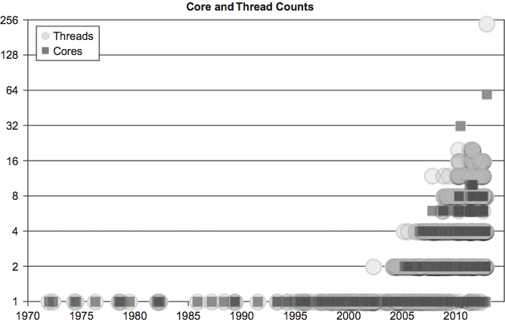
Increasing Parallelism →

Slide 11
IMCI
AVX
SSE
MMX
80386
Increasing Parallelism →
8086, 8088…
8008, 8080
4004
Graph: James Reinders

Slide 12
Parallelism and Performance
There are limits to “automatic” improvement of scalar performance:
The Power Wall: Clock frequency cannot be increased without exceeding air cooling.
The Memory Wall: Access to data is a limiting factor.
The ILP Wall: All the existing instruction-level parallelism (ILP) is already being used.
→ Conclusion: Explicit parallel mechanisms and explicit parallel programming are required for performance scaling.
12

Slide 13
Parallel SW Engineering Considerations
Problem: Amdahl’s Law* notes that scaling will be limited by the serial fraction of your program.
Solution: scale the parallel part of your program faster than the serial part using data parallelism.
Problem: Locking, access to data (memory and communication), and overhead will strangle scaling.
Solution: use programming approaches with good data locality and low overhead, and avoid locks.
Problem: Parallelism introduces new debugging challenges: deadlocks and race conditions.
Solution: use structured programming strategies to avoid these by design, improving maintainability.
*Except Amdahl was an optimist, as we will discuss.
13

Slide 14
PATTERNS

Slide 15
Structured Programming with Patterns
Patterns are “best practices” for solving specific problems.
Patterns can be used to organize your code, leading to algorithms that are more scalable and maintainable.
A pattern supports a particular “algorithmic structure” with an efficient implementation.
Good parallel programming models support a set of useful parallel patterns with low-overhead implementations.
15

Slide 16
Structured Serial Patterns
The following patterns are the basis of “structured programming” for serial computation:
Sequence
Selection
Iteration
Nesting
Functions
Recursion
Random read
Random write
Stack allocation
Heap allocation
Objects
Closures
Compositions of structured serial control flow patterns can be used in place of unstructured mechanisms such as “goto.”
Using these patterns, “goto” can (mostly) be eliminated and the maintainability of software improved.
16

Slide 17
Structured Parallel Patterns
The following additional parallel patterns can be used for “structured parallel programming”:
Superscalar sequence
Speculative selection
Map
Recurrence
Scan
Reduce
Pack/expand
Fork/join
Pipeline
Partition
Segmentation
Stencil
Search/match
Gather
Merge scatter
Priority scatter
*Permutation scatter
!Atomic scatter
Using these patterns, threads and vector intrinsics can (mostly) be eliminated and the maintainability of software improved.
17
Notes:
Most mutexes and semaphores can be eliminated too. Semaphores are truly the “goto” of parallel programming, since a “signal” operation causes a “wait” operation somewhere else to return.

Slide 18
Some Basic Patterns
Serial: Sequence
→ Parallel: Superscalar Sequence
Serial: Iteration
→ Parallel: Map, Reduction, Scan, Recurrence…

Slide 19
(Serial) Sequence
A serial sequence is executed in the exact order given:
F = f(A);
G = g(F);
B = h(G);
19

Slide 20
Superscalar Sequence
Developer writes “serial” code:
F = f(A);
G = g(F);
H = h(B,G);
R = r(G);
P = p(F);
Q = q(F);
S = s(H,R);
C = t(S,P,Q);
Tasks ordered only by data dependencies
Tasks can run whenever input data is ready
20

Slide 21
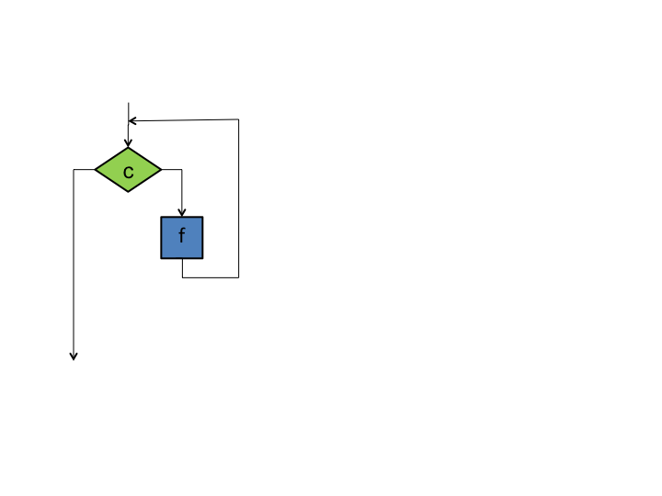
(Serial) Iteration
The iteration pattern repeats some section of code as long as a condition holds
while (c) {
f();
}
Each iteration can depend on values computed in any earlier iteration.
The loop can be terminated at any point based on computations in any iteration
21

Slide 22
(Serial) Countable Iteration
The iteration pattern repeats some section of code a specific number of times
for (i = 0; i<n; ++i) {
f();
}
This is the same as
i = 0;
while (i<n) {
f();
++i;
}
22

Slide 23
Parallel “Iteration”
The serial iteration pattern actually maps to several different parallel patterns
It depends on whether and how iterations depend on each other…
Most parallel patterns arising from iteration require a fixed number of invocations of the body, known in advance

Slide 24
Map
Map replicates a function over every element of an index set
The index set may be abstract or associated with the elements of an array.
Map replaces one specific usage of iteration in serial programs: independent operations.
for (i=0; i<n; ++i) {
f(A[i]);
}
Examples: gamma correction and thresholding in images; color space conversions; Monte Carlo sampling; ray tracing.
24

Slide 25
Reduction
Reduction combines every element in a collection into one element using an associative operator.
b = 0;
for (i=0; i<n; ++i) {
b += f(B[i]);
}
Reordering of the operations is often needed to allow for parallelism.
A tree reordering requires associativity.
Examples: averaging of Monte Carlo samples; convergence testing; image comparison metrics; matrix operations.
25

Slide 26
Scan
Scan computes all partial reductions of a collection
Operator must be (at least) associative.
Diagram shows one possible parallel implementation using three-phase strategy
A[0] = B[0] + init;
for (i=1; i<n; ++i) {
A[i] = B[i] + A[i-1];
}
Examples: random number generation, pack, tabulated integration, time series analysis

Slide 27
Geometric Decomposition/Partition
Geometric decomposition breaks an input collection into sub-collections
Partition is a special case where sub-collections do not overlap
Does not move data, it just provides an alternative “view” of its organization
Examples: JPG and other macroblock compression; divide-and-conquer matrix multiplication; coherency optimization for cone-beam recon.
27

Slide 28
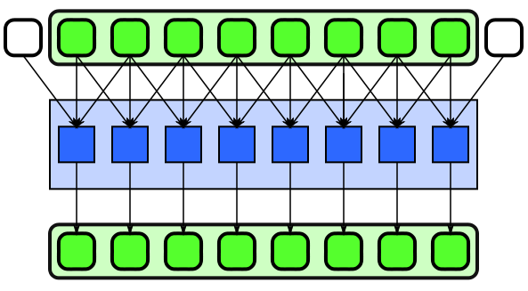
Stencil
Stencil applies a function to neighbourhoods of a collection.
Neighbourhoods are given by set of relative offsets.
Boundary conditions need to be considered, but majority of computation is in interior.
Examples: signal filtering including convolution, median, anisotropic diffusion

Slide 29
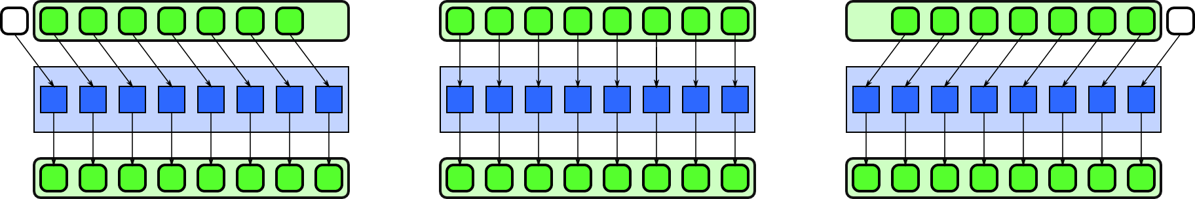
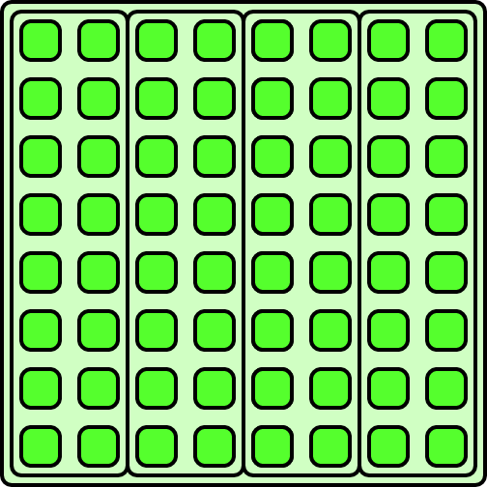
Implementing Stencil
Vectorization can include converting regular reads into a set of shifts.
Strip-mining reuses previously read inputs within serialized chunks.

Slide 30
nD Stencil
nD Stencil applies a function to neighbourhoods of an nD array
Neighbourhoods are given by set of relative offsets
Boundary conditions need to be considered
Examples: image filtering including convolution, median, anisotropic diffusion; simulation including fluid flow, electromagnetic, and financial PDE solvers, lattice QCD
30

Slide 31
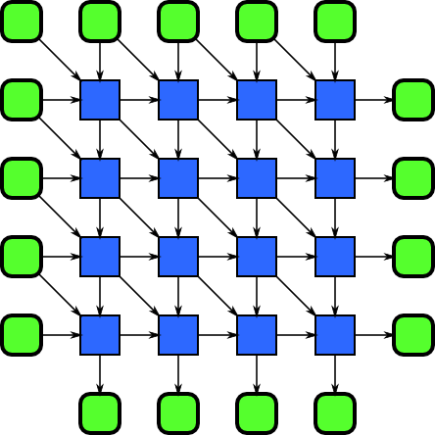
Recurrence
Recurrence results from loop nests with both input and output dependencies between iterations
Can also result from iterated stencils
Examples: Simulation including fluid flow, electromagnetic, and financial PDE solvers, lattice QCD, sequence alignment and pattern matching

Slide 32
Recurrence
for (int i = 1; i < N; i++) {
for (int j = 1; j < M; j++) {
A[i][j] = f(
A[i-1][j],
A[i][j-1],
A[i-1][j-1],
B[i][j]);
}
}

Slide 33
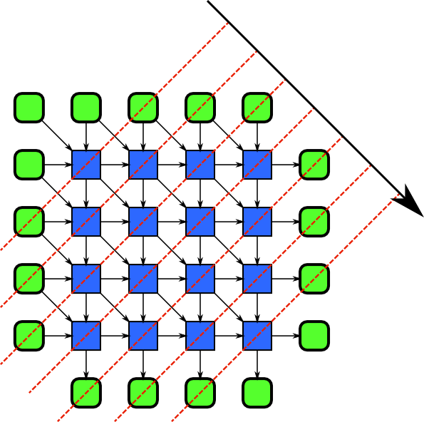
Recurrence Hyperplane Sweep
Multidimensional recurrences can always be parallelized
Leslie Lamport’s hyperplane separation theorem:
Choose hyperplane with inputs and outputs on opposite sides
Sweep through data perpendicular to hyperplane

Slide 34
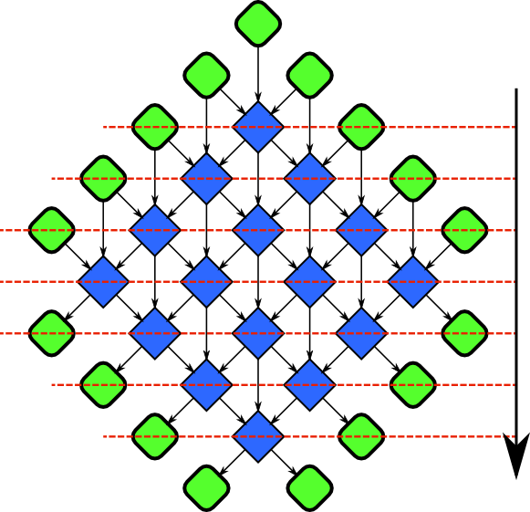
Rotated Recurrence
Rotate recurrence to see sweep more clearly

Slide 35
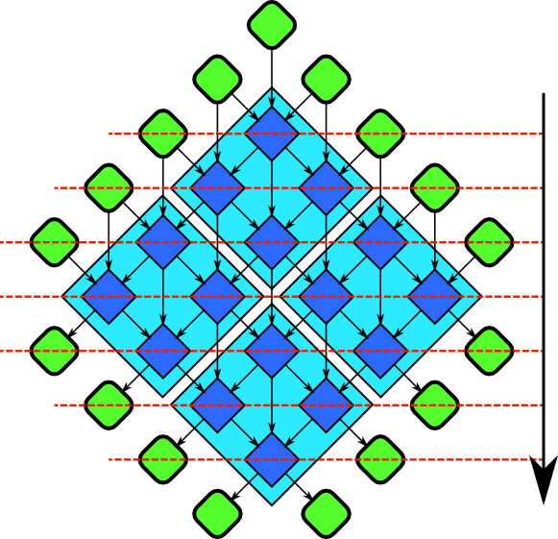
Tiled Recurrence
Can partition recurrence to get a better compute vs. bandwidth ratio
Show diamonds here, could also use paired trapezoids

Slide 36
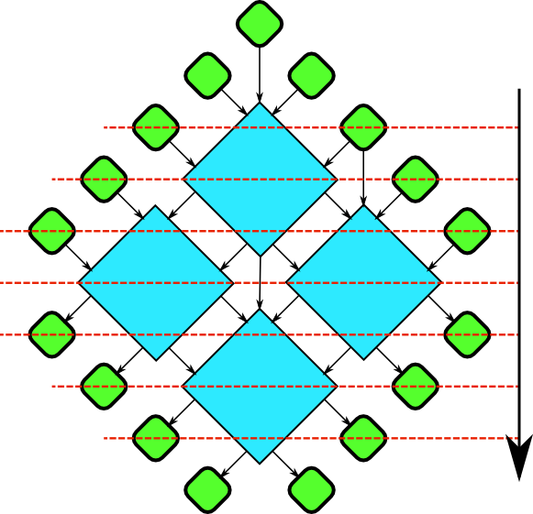
Tiled Recurrence
Remove all non-redundant data dependences

Slide 37
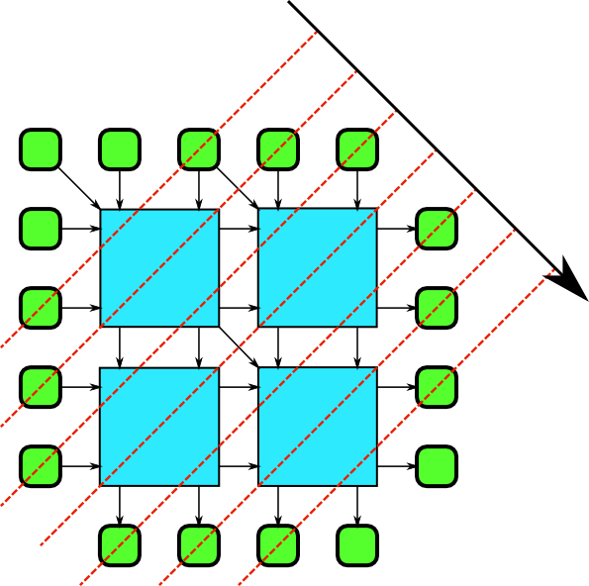
Recursively Tiled Recurrences
Rotate back: same recurrence at a different scale!
Leads to recursive cache-oblivious divide-and-conquer algorithm
Implement with fork-join.

Slide 38
Rotated Recurrence
Look at rotated recurrence again
Let’s skew this by 45 degrees…

Slide 39
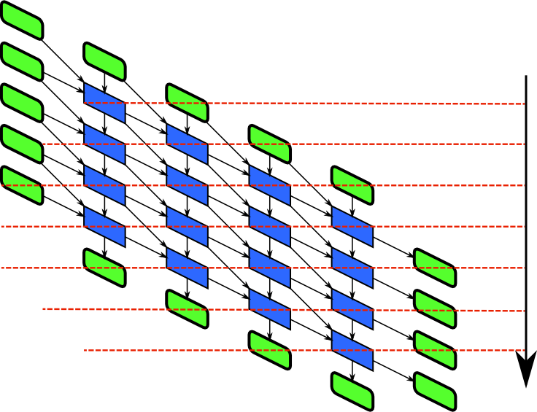
Skewed Recurrence
A little hard to understand
Let’s just clean up the diagram a little bit…
Straighten up the symbols
Leave the data dependences as they are

Slide 40
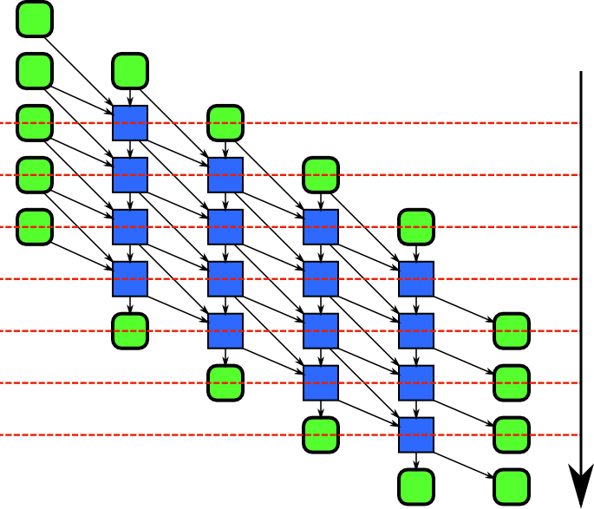
Skewed Recurrence
This is a useful memory layout for implementing recurrences
Let’s now focus on one element
Look at an element away from the boundaries

Slide 41
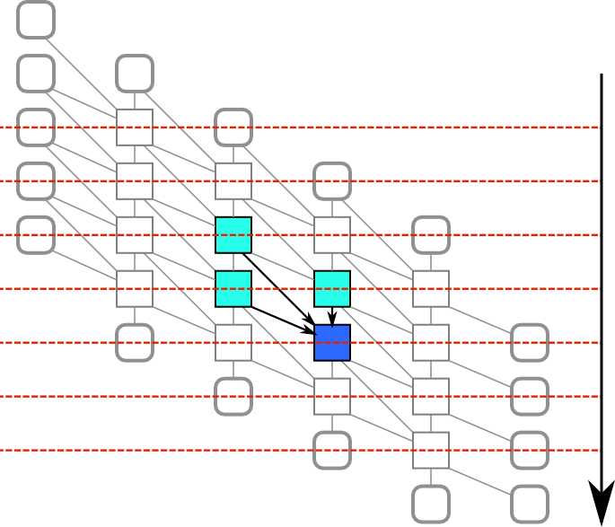
Recurrence = Iterated Stencil
Each element depends on certain others in previous iterations
An iterated stencil!
Convert iterated stencils into tiled recurrences for efficient implementation

Slide 42
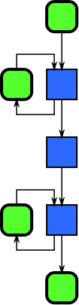
Pipeline
Pipeline uses a sequence of stages that transform a flow of data
Some stages may retain state
Data can be consumed and produced incrementally: “online”
Examples: image filtering, data compression and decompression, signal processing

Slide 43
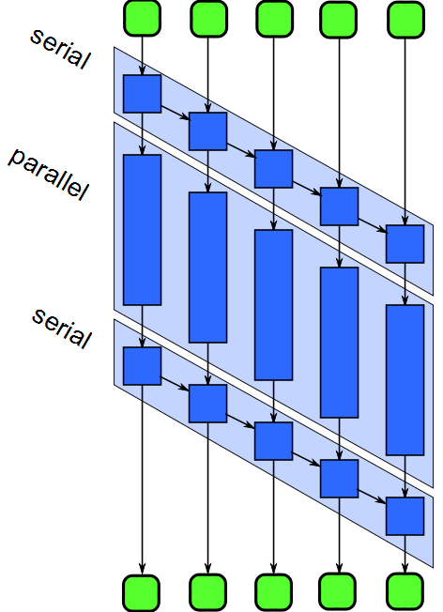
Pipeline
Parallelize pipeline by
Running different stages in parallel
Running multiple copies of stateless stages in parallel
Running multiple copies of stateless stages in parallel requires reordering of outputs
Need to manage buffering between stages

Slide 44
Recursive Patterns
Recursion is an important “universal” serial pattern
Recursion leads to functional programming
Iteration leads to procedural programming
Structural recursion: nesting of components
Dynamic recursion: nesting of behaviors

Slide 45
Nesting: Recursive Composition
45

Slide 46
Fork-Join: Efficient Nesting
Fork-join can be nested
Spreads cost of work distribution and synchronization.
This is how cilk_for, tbb::parallel_for and arbb::map are implemented.
Recursive fork-join enables high parallelism.

Slide 47
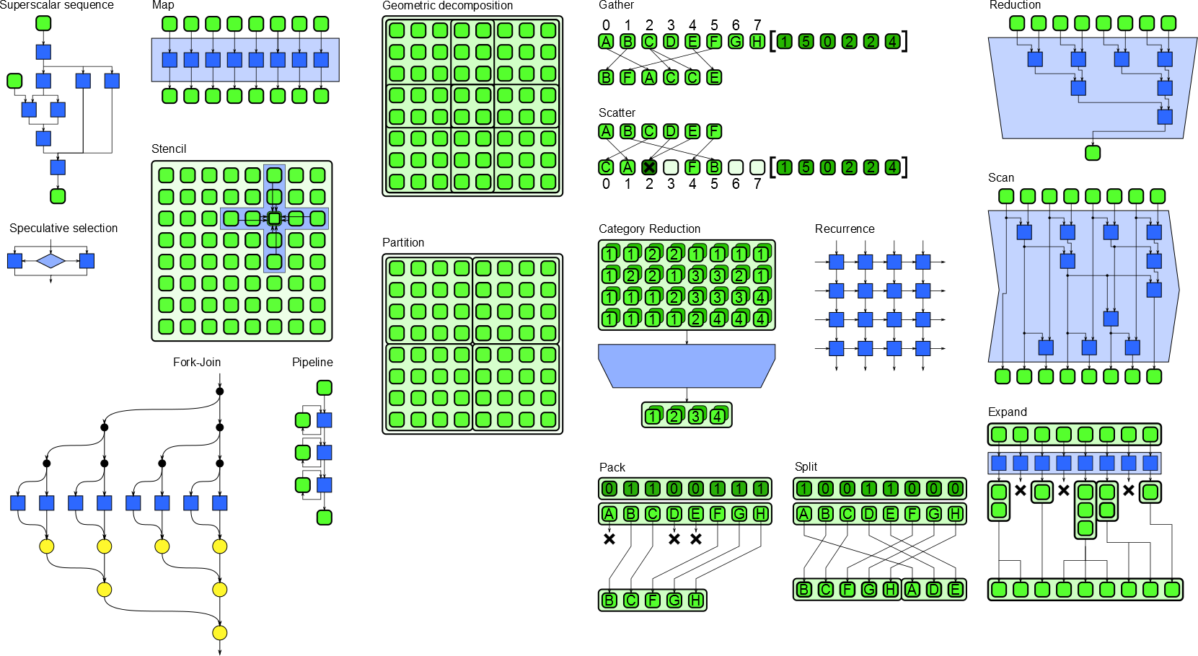
Parallel Patterns: Overview
47

Slide 48
Semantics and Implementation
Semantics: What
The intended meaning as seen from the “outside”
For example, for scan: compute all partial reductions given an associative operator
Implementation: How
How it executes in practice, as seen from the “inside”
For example, for scan: partition, serial reduction in each partition, scan of reductions, serial scan in each partition.
Many implementations may be possible
Parallelization may require reordering of operations
Patterns should not over-constrain the ordering; only the important ordering constraints are specified in the semantics
Patterns may also specify additional constraints, i.e. associativity of operators

Slide 49
CLUSTER ACCESS
Class students were given access to a cluster to work on for a week.

Slide 50
Running Examples on Endeavour
Connect via SSH or Putty
(optional) use “screen” to protect against disconnects
Connect to a compute node in an LSF job
Set up compiler environment
Compile and run on a host system
Compile and run on a Intel® Xeon Phi™ coprocessor

Slide 51
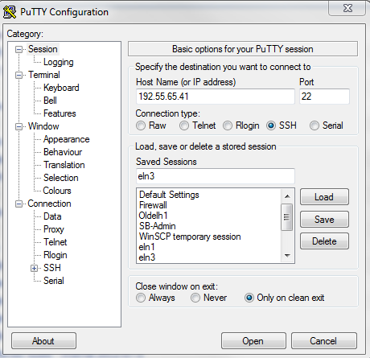
Connecting with PuTTY
Under Session Fill in IP address: 207.108.8.212
Be sure to give this entry a descriptive name such as Endeavor.
Click “save”
Click “open”

Slide 52
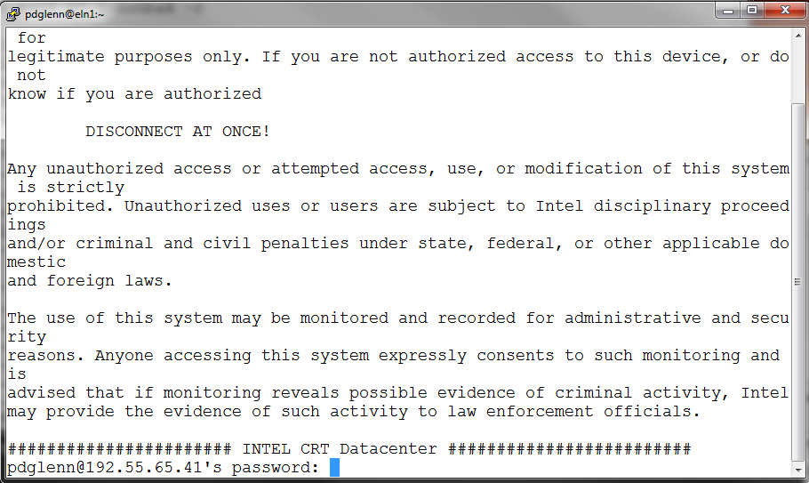
Connecting with PuTTY II
A successful connection should look like:
Enter user name and password

Slide 53
Introduction to “screen”
It is a screen manager with VT100/ANSI terminal emulation
Screen is a full-screen window manager that multiplexes a physical terminal between several processes (typically interactive shells)
Allows to host multiple parallel programs in a single Putty window
Protects from connection resets - allows you to reconnect after you establish a new ssh connection
All windows run their programs completely independent of each other. Programs continue to run when their window is currently not visible and even when the whole screen session is detached from the user’s terminal.
when a program terminates, screen (per default) kills the Window that contained it. If this window was in the foreground, the display switches to the previous window;
if none are left, screen exits.

Slide 54
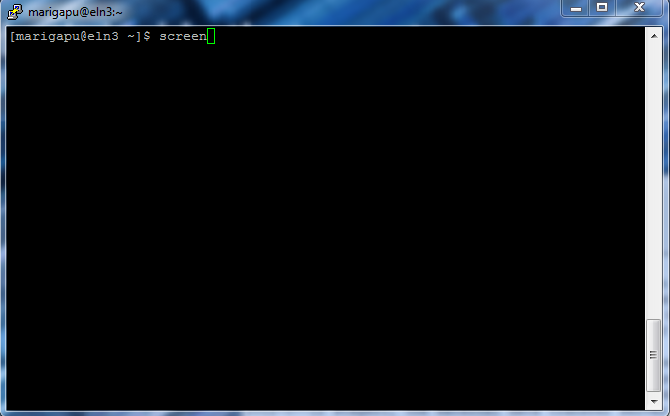
Screen Example I
Logon to Endeavour login node as usual. Type ‘screen’ at the prompt.

Slide 55
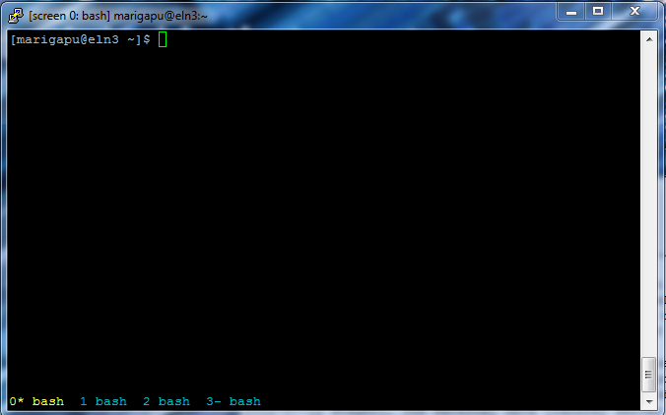
Screen Example II
By simply pressing “Ctrl-a c” keys, you can open another shell window within the same screen session. At the bottom you will see the session number. You can switch between the sessions by pressing “Ctrl-a <number_of_the screen>”

Slide 56
Screen Example III
You can recover the shell back by doing ‘screen -r’. You will be able to get the same shell where you left off. You can end the screen session by either ‘exit’ or ‘Ctrl d’

Slide 57
Start an Interactive LSF Job
Reserve a compute node for 600 minutes:
$ bsub -R 1*"{select[ivt]}" -W 600 -Is /bin/bash
Wait till you see: Prologue finished, program starts
Retrieve hostname of the system
$ hostname
esg061
Exit the job:
$ logout

Slide 58
Compile and Run on HOST
Reserve a node
$ bsub -R '1*{select[ivt]}' -W 600 -Is /bin/bash
Source compiler environment
$ . env.sh
Compile and run your program
$ icc –o foo foo.c
$ ./foo
$ icpc –o foopp foo.cpp
$ ./foopp

Slide 59
Compile and Run on Intel®Xeon Phi™
Source compiler environment
$ . env.sh
Compile your program
$ icc –o foo –mmic foo.c
ssh to the Intel® Xeon Phi™ coprocessor and execute your program
$ ssh `hostname`-mic0
$ . env-mic.sh
$ ./foo

Slide 60
PROGRAMMING MODELS

Slide 61
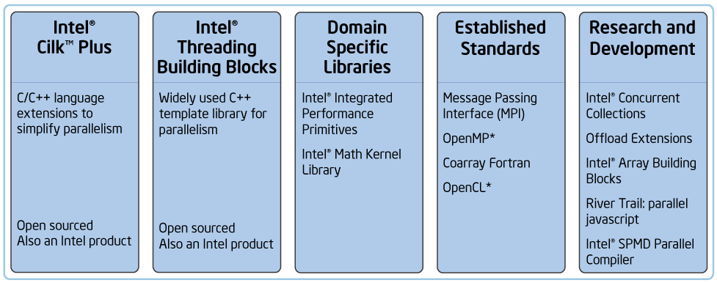
Intel’s Parallel Programming Models
Choice of high-performance parallel programming models
Libraries for pre-optimized and parallelized functionality
Intel® Cilk™ Plus and Intel® Threading Building Blocks supports composable parallelization of a wide variety of applications.
OpenCL* addresses the needs of customers in specific segments, and provides developers an additional choice to maximize their app performance
MPI supports distributed computation, combines with other models on nodes
61

Slide 62
Intel’s Parallel Programming Models
Intel® Cilk™ Plus: Compiler extension
Fork-join parallel programming model
Serial semantics if keywords are ignored (serial elision)
Efficient work-stealing load balancing, hyperobjects
Supports vector parallelism via array slices and elemental functions
Intel® Threading Building Blocks (TBB): Library
Template library for parallelism
Efficient work-stealing load balancing
Efficient low-level primitives (atomics, memory allocation).
62

Slide 63
SSE Intrinsics
Plain C/C++
float sprod(float *a, float *b, int size) {
float sum = 0.0;
for (int i=0; i < size; i++)
sum += a[i] * b[i];
return sum;
}
SSE
float sprod(float *a, float *b, int size){
_declspec(align(16)) __m128 sum, prd, ma, mb;
float tmp = 0.0;
sum = _mm_setzero_ps();
for(int i=0; i<size; i+=4){
ma = _mm_load_ps(&a[i]);
mb = _mm_load_ps(&b[i]);
prd = _mm_mul_ps(ma,mb);
sum = _mm_add_ps(prd,sum);
}
prd = _mm_setzero_ps();
sum = _mm_hadd_ps(sum, prd);
sum = _mm_hadd_ps(sum, prd);
_mm_store_ss(&tmp, sum);
return tmp;
}
63

Slide 64
SSE Intrinsics
Plain C/C++
float sprod(float *a, float *b, int size) {
float sum = 0.0;
for (int i=0; i < size; i++)
sum += a[i] * b[i];
return sum;
}
SSE
float sprod(float *a, float *b, int size){
_declspec(align(16)) __m128 sum, prd, ma, mb;
float tmp = 0.0;
sum = _mm_setzero_ps();
for(int i=0; i<size; i+=4){
ma = _mm_load_ps(&a[i]);
mb = _mm_load_ps(&b[i]);
prd = _mm_mul_ps(ma,mb);
sum = _mm_add_ps(prd,sum);
}
prd = _mm_setzero_ps();
sum = _mm_hadd_ps(sum, prd);
sum = _mm_hadd_ps(sum, prd);
_mm_store_ss(&tmp, sum);
return tmp;
}
Problems with SSE code:
Machine dependent
Assumes vector length 4
Verbose
Hard to maintain
Only vectorizes
SIMD instructions, no threads
Example not even complete:
Array must be multiple of vector length
64

Slide 65
Cilk™ Plus
Plain C/C++
float sprod(float *a, float *b, int size) {
float sum = 0;
for (int i=0; i < size; i++)
sum += a[i] * b[i];
return sum;
}
Cilk™ Plus
float sprod(float a*, float b*, int size) {
return __sec_reduce_add(
a[0:size] * b[0:size] );
}
65

Slide 66
Cilk™ Plus + Partitioning
Plain C/C++
float sprod(float *a, float *b, int size) {
float sum = 0;
for (int i=0; i < size; i++)
sum += a[i] * b[i];
return sum;
}
Cilk™ Plus
float sprod(float* a, float* b, int size) {
int s = 4096;
cilk::reducer<cilk::op_add<float> >sum(0);
cilk_for (int i=0; i<size; i+=s) {
int m = std::min(s,size-i);
*sum += __sec_reduce_add(
a[i:m] * b[i:m] );
}
return sum.get_value();
}
66

Slide 67
TBB
Plain C/C++
float sprod(float *a, float *b, int size) {
float sum = 0;
for (int i=0; i < size; i++)
sum += a[i] * b[i];
return sum;
}
TBB
float sprod(const float a[], const float b[], size_t n ) {
return tbb::parallel_reduce(
tbb::blocked_range<size_t>(0,n),
0.0f,
[=](
tbb::blocked_range<size_t>& r,
float in
) {
return std::inner_product(
a+r.begin(), a+r.end(),
b+r.begin(), in );
},
std::plus<float>()
);
}
67

Slide 68
Patterns in Intel’s Parallel Programming Models
Intel® Cilk™ Plus
cilk_spawn, cilk_sync: nesting, fork-join
Hyperobjects: reduce
cilk_for, elemental functions: map
Array notation: scatter, gather
Intel® Threading Building Blocks
parallel_invoke, task_group: nesting, fork-join
parallel_for, parallel_foreach: map
parallel_do: workpile (map + incr. task addition)
parallel_reduce, parallel_scan: reduce, scan
parallel_pipeline: pipeline
flow_graph: plumbing for reactive and streaming
68

Slide 69
Conclusions
Explicit parallelism is a requirement for scaling
Moore’s Law is still in force.
However, it is about number of transistors on a chip, not scalar performance.
Patterns are a structured way to think about applications and programming models
Useful for communicating and understanding structure
Useful for achieving a scalable implementation
Good parallel programming models support scalable parallel patterns
Parallelism, data locality, determinism
Low-overhead implementations
69

Slide 70
MACHINE MODELS

Slide 71
Course Outline
Introduction
Motivation, goals, patterns
Background
Machine model, complexity, work-span
Cilk™ Plus and Threading Building Blocks
Programming model
Examples
Practical matters
Debugging and profiling

Slide 72
Background: Outline
Machine model
Parallel hardware mechanisms
Memory architecture and hierarchy
Speedup and efficiency
DAG model of computation
Greedy scheduling
Work-span parallel complexity model
Brent’s Lemma and Amdahl’s Law
Amdahl was an optimist: better bounds with work-span
Parallel slack
Potential vs. actual parallelism
72

Slide 73
What you (probably) want
Performance
Compute results efficiently
Improve absolute computation times over serial implementations
Portability
Code that work well on a variety of machines without significant changes
Scalable: make efficient use of more and more cores
Productivity
Write code in a short period of time
Debug, validate, and maintain it efficiently

Slide 74
Typical System Architecture

Slide 75
Cache Hierarchy

Slide 76
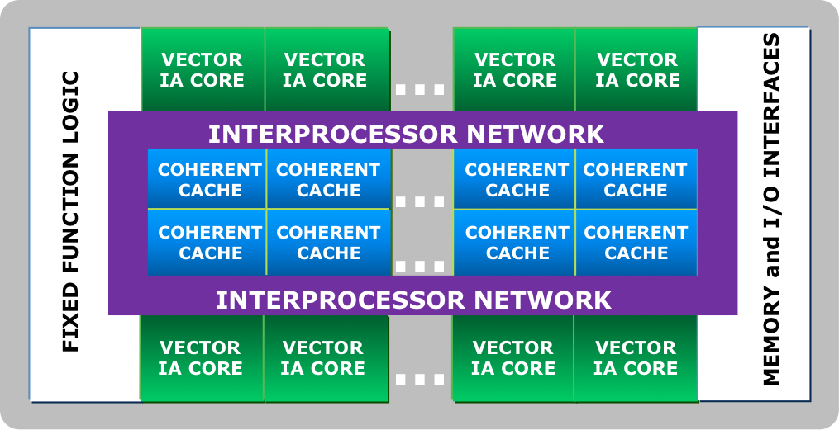
Xeon Phi (MIC) Architecture

Slide 77
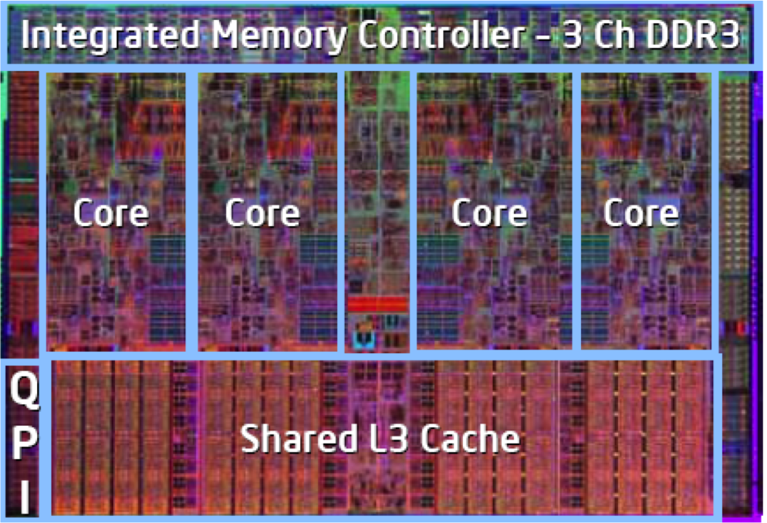
Nehalem

Slide 78
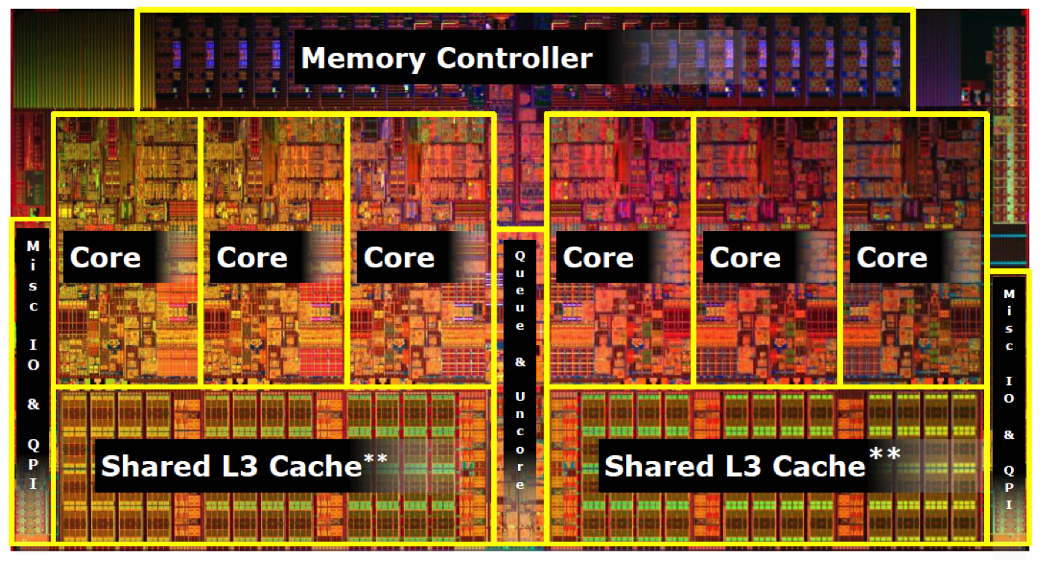
Westmere

Slide 79
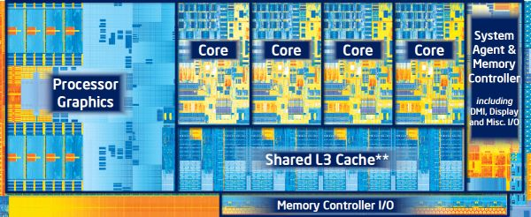
Ivy Bridge

Slide 80
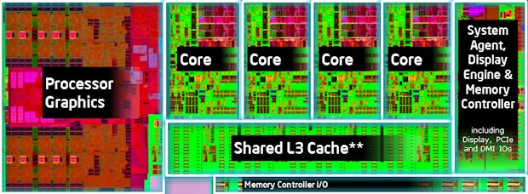
Haswell

Slide 81
Key Factors
Compute: Parallelism
What mechanisms do processors provide for using parallelism?
Implicit: instruction pipelines, superscalar issues
Explicit: cores, hyperthreads, vector units
How to map potential parallelism to actual parallelism?
Data: Locality
How is data managed and accessed, and what are the performance implications?
Cache behavior, conflicts, sharing, coherency, (false) sharing; alignments with cache lines, pages, vector lanes
How to design algorithms that have good data locality?

Slide 82
Pitfalls
Load imbalance
Too much work on some processors, too little on others
Overhead
Too little real work getting done, too much time spent managing the work
Deadlocks
Resource allocation loops causing lockup
Race conditions
Incorrect interleavings permitted, resulting in incorrect and non-deterministic results
Strangled scaling
Contended locks causing serialization

Slide 83
Data Layout: AoS vs. SoA
Array of structures (AoS) tends to cause cache alignment problems, and is hard to vectorize.
Structure of arrays (SoA) can be easily aligned to cache boundaries and is vectorizable.

Slide 84
Data Layout: Alignment

Slide 85
COMPLEXITY MEASURES

Slide 86
Speedup and Efficiency
T₁ = time to run with 1 worker
T_{P} = time to run with P workers
T₁/T_{P} = speedup
The relative reduction in time to complete the same task
Ideal case is linear in P
i.e. 4 workers gives a best-case speedup of 4.
In real cases, speedup often significantly less
In rare cases, such as search, can be superlinear
T₁/(PT_{P}) = efficiency
1 is perfect efficiency
Like linear speedup, perfect efficiency is hard to achieve
Note that this is not the same as “utilization”
86

Slide 87
DAG Model of Computation
Program is a directed acyclic graph (DAG) of tasks
The hardware consists of workers
Scheduling is greedy
No worker idles while there is a task available.
87

Slide 88
Departures from Greedy Scheduling
Contended mutexes.
Blocked worker could be doing another task
One linear stack per worker
Caller blocked until callee completes
Avoid mutexes, use wait-free atomics instead.
Intel® Cilk™ Plus has cactus stack.
Intel® TBB uses continuation-passing style inside algorithm templates.

Slide 89
Work-Span Model
T_{P} = time to run with P workers
T₁ = work
time for serial execution
sum of all work
T∞ = span
time for critical path
89
Notes:
Assume one work unit per node and free synchronization.
Then the work is the number of nodes and the span is the longest path, also called the critical path.
What is the work and span for the figure on the right?

Slide 90
Work-Span Example
T₁ = work = 7
T∞ = span = 5
90
Notes:
Assume one work unit per node. The work is the number of nodes (7). The span is the longest path (5).

Slide 91
Burdened Span
Includes extra cost for synchronization
Often dominated by cache line transfers.
91
Notes:
Assume one work unit per node. The work is the number of nodes (7). The span is the longest path. What is the span for the figure on the right?

Slide 92
Lower Bound on Greedy Scheduling
Work-Span Limit
max(T₁/P, T∞) ≤ T_{P}
92
Notes:
Note how T∞ generalizes Amdahl’s Law. Instead of saying there is a serial portion of a program, we say there is a incompressible path with time T∞
Amdahl analysis would say there is a serial portion with 2 nodes and a parallel portion with 5 nodes.
Amdahl assumes parallel portion can be (at best) perfectly parallelized. So Amdahl estimates that T∞ ≥ 2, which is a correct, but loose, bound.

Slide 93
Upper Bound on Greedy Scheduling
Brent’s Lemma
T_{P} ≤ (T₁-T∞)/P + T∞
93
Notes:
Animation shows the proof for 2 processors. In the worst case, both processors choose to not work on the critical path.
At each time step, any processors idling because they are not working on the critical path are chomping on the T₁-T∞ part.

Slide 94
Applying Brent’s Lemma to 2 Processors
T₁ = 7
T∞= 5
T₂ ≤ (T₁-T∞)/P + T∞
≤(7-5)/2 + 5
≤ 6
94
Notes:
DAG is topologically identical to DAG on previous slide, but shows worse case for 2 processors.
The processors made the unfortunate choice of starting off the critical path.
But at least they were busy.
The (T₁-T∞ ) part of the Lemma is saying “all processors are busy”. The T∞ part is saying “not all processors are busy because of constraints.”
In this example, two processors could do better if the critical path was known ahead of time. But in general the graphs will be complicated, the time per task will be variable, there are many such critical paths.

Slide 95
Amdahl Was An Optimist
Amdahl’s Law
T_{serial} + T_{parallel}/P ≤ T_{P}
Notes:
Amdahl’s Law in our example, T_{serial}=2 and T_{parallel} =5. The argument is that in the best case, the parallel work can be perfectly parallelized. Notice how far off this is for our example. The “parallel part” has a critical path of 3. So Amdahl’s Law is not very useful on two counts: its upper bound on speedup is way too high, and it fails to provide any hint about what is possible. Work-span analysis gives us both bounds.

Slide 96
Estimating Running Time
Scalability requires that T∞ be dominated by T_{1.}
Increasing work hurts parallel execution proportionately.
The span impacts scalability, even for finite P.
T_{P} ≈ T₁/P + T∞ if T∞<< T₁

Slide 97
Parallel Slack
Sufficient parallelism implies linear speedup.
T_{P} ≈ T₁/P if T₁/T∞>> P
Linear speedup
Parallel slack

Slide 98
Definitions for Asymptotic Notation
T(N) = O(f(N)) ≡ T(N) ≤ c·f(N) for some constant c.
T(N) = Ω(f(N)) ≡ T(N) ≥ c·f(N) for some constant c.
T(N) = Θ(f(N)) ≡ c₁·f(N) ≤ T(N) ≤ c₂·f(N) for some constants c1 and c2.
Quiz: If T₁(N) = O(N²) and T∞ (N) = O(N), then T₁/T∞ = ?
O(N)
O(1)
O(1/N)
all of the above
need more information

Slide 99
Amdahl vs. Gustafson-Baris
Amdahl

Slide 100
Amdahl vs. Gustafson-Baris
Gustafson-Baris

Slide 101
Optional Versus Mandatory Parallelism
Task constructs in Intel® TBB and Cilk™ Plus grant permission for parallel execution, but do not mandate it.
Exception: TBB’s std::thread (a.k.a. tbb::tbb_thread)
Optional parallelism is key to efficiency
You provide parallel slack (over decomposition).
Potential parallelism should be greater than physical parallelism.
TBB and Cilk Plus convert potential parallelism to actual parallelism as appropriate.
A task is an opportunity for parallelism

Slide 102
Reminder of Some Assumptions
Memory bandwidth is not a limiting resource.
There is no speculative work.
The scheduler is greedy.

Slide 103
Intel® CilkTM Plus and Intel® Threading Building Blocks (TBB)

Slide 104
Course Outline
Introduction
Motivation, goals, patterns
Background
Machine model, complexity, work-span
CilkTM Plus and Threading Building Blocks
Programming model
Examples
Practical matters
Debugging and profiling

Slide 105
Cilk™ Plus and TBB: Outline
Feature summaries
C++ review
Map pattern
Reduction pattern
Fork-join pattern
Example: polynomial multiplication
Complexity analysis
Pipeline pattern
Full code examples for these patterns can be downloaded from http://parallelbook.com/downloads
105

Slide 106
Summary of Cilk™ Plus
Thread Parallelism
cilk_spawn
cilk_sync
cilk_for
Reducers
reducer
reducer_op{add,and,or,xor}
reducer_{min,max}{_index}
reducer_list_{append,prepend}
reducer_ostream
reducer_string
holder
Vector Parallelism
array notation
#pragma simd
elemental functions

Slide 107
TBB 4.0 Components
Parallel Algorithms
parallel_for
parallel_for_each
parallel_invoke
parallel_do
parallel_scan
parallel_sort
parallel_[deterministic]_reduce
Macro Dataflow
parallel_pipeline
tbb::flow::...
Concurrent Containers
concurrent_hash_map
concurrent_unordered_{map,set}
concurrent_[bounded_]queue
concurrent_priority_queue
concurrent_vector
Task scheduler
task_group, structured_task_group
task
task_scheduler_init
task_scheduler_observer
Thread Local Storage
combinable
enumerable_thread_specific
Synchronization Primitives
atomic, condition_variable
[recursive_]mutex
{spin,queuing,null} [_rw]_mutex
critical_section, reader_writer_lock
Memory Allocation
tbb_allocator
zero_allocator
cache_aligned_allocator
scalable_allocator
Threads
std::thread
Notes:
Item in blue are common subset shared with Microsoft PPL.
Some components are useful for other models. The containers, thread-local storage, and memory allocators, and synchronization primitives work with native threads too.
tbb::flow::... is a large subsystem targeting macro data flow. It will not be covered in this tutorial.

Slide 108
C++ Review
“Give me six hours to chop down a tree and I will spend the first four sharpening the axe.”
- Abraham Lincoln
Notes:
You will need the axe for Threading Building Blocks, not for Cilk Plus.

Slide 109
C++ Review: Half Open Interval
STL specifies a sequence as a half-open interval [first,last)
last−first == size of interval
first==last ⇔ empty interval
If object x contains a sequence
x.begin() points to first element.
x.end() points to “one past last” element.
void PrintContainerOfTypeX( const X& x ) {
for( X::iterator i=x.begin(); i!=x.end(); ++i )
cout << *i << endl;
}
Notes:
Iterator is a generalization of a pointer. It is a user-defined type that acts somewhat like a pointer.

Slide 110
C++ Review: Function Template
Type-parameterized function.
Strongly typed.
Obeys scope rules.
Actual arguments evaluated exactly once.
Not redundantly instantiated.
template<typename T>
void swap( T& x, T& y ) {
T z = x;
x = y;
y = z;
}
[first,last) define half-open interval
void reverse( float* first, float* last ) {
while( first<last-1 )
swap( *first++, *--last );
}
Compiler instantiates template swap with T=float.
Notes:
In C++11, swap would be written differently in order to exploit “move’’ semantics.
Note side effects in actual arguments to swap.

Slide 111
Genericity of swap
template<typename T>
void swap( T& x, T& y ) {
T z = x;
x = y;
y = z;
}
Construct a copy
Assign
Destroy z
C++03 Requirements for T
T(const T&) | Copy constructor
void T::operator=(const T&) | Assignment
~T() | Destructor
Notes:
C++11 weakens (generalizes) the requirements to “move constructible” and “move assignable”.

Slide 112
C++ Review: Template Class
Type-parameterized class
template<typename T, typename U>
class pair {
public:
T first;
U second;
pair( const T& x, const U& y ) : first(x), second(y) {}
};
pair<string,int> x;
x.first = “abc”;
x.second = 42;
Compiler instantiates template pair with T=string and U=int.

Slide 113
C++ Function Object
Also called a “functor”
Is object with member operator().
class LinearOp {
float a, b;
public:
float operator() ( float x ) const {return a*x+b;}
Linear( float a_, float b_ ) : a(a_), b(b_) {}
};
LinearOp f(2,5);
y = f(3);
Could write as
y = f.operator()(3);

Slide 114
Template Function + Functor = Flow Control
template<typename I, typename Func>
void ForEach( I lower, I upper, const Func& f ) {
for( I i=lower; i<upper; ++i )
f(i);
}
Template function for iteration
class Accumulate {
float& acc;
float* src;
public:
Accumulate( float& acc_, float* src_ ) : acc(acc_), src(src_) {}
void operator()( int i ) const {acc += src[i];}
};
Functor
float Example() {
float a[4] = {1,3,9,27};
float sum = 0;
ForEach( 0, 4, Accumulate(sum,a) );
return sum;
}
Pass functor to template function.
Functor becomes “body” of control flow “statement”.

Slide 115
So Far
Abstract control structure as a template function.
Encapsulate block of code as a functor.
Template function and functor can be arbitrarily complex.

Slide 116
Recap: Capturing Local Variables
Local variables were captured via fields in the functor
Field holds reference to sum.
class Accumulate {
float& acc;
float* src;
public:
Accumulate( float& acc_, float* src_ ) : acc(acc_), src(src_) {}
void operator()( int i ) const {acc += src[i];}
};
Capture reference to sum in acc.
float Example() {
float a[4] = {1,3,9,27};
float sum = 0;
ForEach( 0, 4, Accumulate(sum,a) );
return sum;
}
Use reference to sum.
Formal parameter acc_ bound to local variable sum

Slide 117
Array Can Be Captured as Pointer Value
Field for capturing a declared as a pointer.
class Accumulate {
float& acc;
float* src;
public:
Accumulate( float& acc_, float* src_ ) : acc(acc_), src(src_) {}
void operator()( int i ) const {acc += src[i];}
};
float Example() {
float a[4] = {1,3,9,27};
float sum = 0;
ForEach( 0, 4, Accumulate(sum,a) );
return sum;
}
a implicitly converts to pointer

Slide 118
An Easier Naming Scheme
Name each field and parameter after the local variable that it captures.
This is tedious mechanical work.
Can we make the compiler do it?
class Accumulate {
float& sum;
float* a;
public:
Accumulate( float& sum_, float* a_ ) : sum(sum_), a(a_) {}
void operator()( int i ) const {sum += a[i];}
};
float Example() {
float a[4] = {1,3,9,27};
float sum = 0;
ForEach( 0, 4, Accumulate(sum,a) );
return sum;
}

Slide 119
C++11 Lambda Expression
Part of C++11
Concise notation for functor-with-capture.
Available in recent Intel, Microsoft, GNU C++, and clang++ compilers.
 |  | Intel Compiler Version
 |  | 11.* | 12.* | 13.*, 14.*
Platform | Linux* OS | -std=c++0x |  | -std=c++11 (or –std=c++0x)
 | Mac* OS
 | Windows* OS | /Qstd:c++0x | on by default

Slide 120
With Lambda Expression
class Accumulate {
float& acc;
float* src;
public:
Accumulate( float& acc_, float* src_ ) : acc(acc_), src(src_) {}
void operator()( int i ) const {acc += src[i];}
};
Compiler automatically defines custom functor type tailored to capture sum and a.
float Example() {
float a[4] = {1,3,9,27};
float sum = 0;
ForEach( 0, 4, [&]( int i ) {sum += a[i];} );
return sum;
}
[&] introduces lambda expression that constructs instance of functor.
Parameter list and body for functor::operator()

Slide 121
Lambda Syntax
[capture_mode] (formal_parameters) -> return_type {body}
[&] ⇒ by-reference
[=] ⇒ by-value
[] ⇒ no capture
Can omit if there are no parameters and return type is implicit.
Can omit if return type is void or code is “return expr;”
Examples
[&](float x) {sum+=x;}
[]{return rand();}
[&]{return *p++;}
[](float x, float y)->float {
if(x<y) return x;
else return y;
}
[=](float x) {return a*x+b;}
Not covered here: how to specify capture mode on a per-variable basis.
121

Slide 122
Note About Anonymous Types
Lambda expression returns a functor with anonymous type.
Thus lambda expression is typically used only as argument to template function or with C++11 auto keyword.
Later we’ll see two other uses unique to Cilk Plus.
template<typename F>
void Eval( const F& f ) {
f();
}
void Example1() {
Eval( []{printf(“Hello, world\n”);} );
}
Template deduces functor’s type instead of specifying it.
Expression []{...} has anonymous type.
void Example2() {
auto f = []{printf(“Hello, world\n”);};
f();
}
Compiler deduces type of f from right side expression.

Slide 123
Note on Cilk™ Plus Keywords
Include <cilk/cilk.h> to get nice spellings
#define cilk_spawn _Cilk_spawn
#define cilk_sync _Cilk_sync
#define cilk_for _Cilk_for
In <cilk/cilk.h>
// User code
#include <cilk/cilk.h>
int main() {
cilk_for( int i=0; i<10; ++i ) {
cilk_spawn f();
g();
cilk_sync;
}
}
Notes:
The examples in the presentation assume that <cilk/cilk.h> has been included.

Slide 124
Cilk™ Plus Elision Property
Cilk program has corresponding serialization
Equivalent to executing program with single worker.
Different ways to force serialization:
#include <cilk/cilk_stub.h> at top of source file
Command-line option
icc: -cilk-serialize
icl: /Qcilk-serialize
Visual Studio:
Properties → C/C++ → Language [Intel C++] → Replace Intel Cilk Plus Keywords with Serial Equivalents
#define _Cilk_sync
#define _Cilk_spawn
#define _Cilk_for for
In <cilk/cilk_stub.h>

Slide 125
Note on TBB Names
Most public TBB names reside in namespace tbb
C++11 names are in namespace std.
Microsoft PPL names can be injected from namespace tbb into namespace Concurrency.
#include "tbb/tbb.h"
using namespace tbb;
#include "tbb/compat/condition_variable"
#include "tbb/compat/thread"
#include "tbb/compat/tuple"
#include "tbb/compat/ppl.h"
Notes:
Examples assume “using namespace tbb;”.
Public names are often typedefs to names in version namespaces. You will see the versioned name in the debugger.
Likewise the names in namespace std are just typedefs to versioned names, to avoid collisions with eventual platform implementations of those names.

Slide 126
Map Pattern
Intel® Cilk™ Plus
Intel®TBB
a[0:n] = f(b[0:n]);
parallel_for( 0, n, [&]( int i ) {
a[i] = f(b[i]);
});
#pragma simd
for( int i=0; i<n; ++i )
a[i] = f(b[i]);
parallel_for(
blocked_range<int>(0,n),
[&](blocked_range<int> r ) {
for( int i=r.begin(); i!=r.end(); ++i )
a[i] = f(b[i]);
});
cilk_for( int i=0; i<n; ++i )
a[i] = f(b[i]);
Notes:
Lots of syntaxes, driven by different design points.
We’ll go into each syntax in more detail.

Slide 127
Map in Array Notation
Lets you specify parallel intent
Give license to the compiler to vectorize
// Set y[i] ← y[i] + a ⋅x[i] for i∈[0..n)
void saxpy(float a, float x[], float y[], size_t n ) {
y[0:n] += a*x[0:n];
}
127

Slide 128
Array Section Notation
Pointer or array
base[first:length:stride]
Optional stride
First index
Number of elements (different than F90!)
Rules for section₁ op section₂
Elementwise application of op
Also works for func(section₁ , section₂)
Sections must be the same length
Scalar arguments implicitly extended
128

Slide 129
More Examples
Rank 2 Example – Update m×n tile with corner [i][j].
Vx[i:m][j:n] += a*(U[i:m][j+1:n]-U[i:m][j:n]);
Scalar implicitly extended
Function call
theta[0:n] = atan2(y[0:n],1.0);
Gather/scatter
w[0:n] = x[i[0:n]];
y[i[0:n]] = z[0:n];
129

Slide 130
Improvement on Fortran 90
Compiler does not generate temporary arrays.
Would cause unpredictable space demands and performance issues.
Want abstraction with minimal penalty.
Partial overlap of left and right sides is undefined.
Exact overlap still allowed for updates.
Just like for structures in C/C++.
x[0:n] = 2*x[1:n]; // Undefined – partial overlap*
x[0:n] = 2*x[0:n]; // Okay – exact overlap
x[0:n:2] = 2*x[1:n:2]; // Okay – interleaved
*unless n≤1.
130
Notes:
12.0 compiler did generate temporary arrays like F90, but space demands were unpredictable.

Slide 131
Mapping a Statement with Array Notation
template<typename T>
T* destructive_move( T* first, T* last, T* output ) {
size_t n = last-first;
[]( T& in, T& out ){
out = std::move(in);
in.~T();
} ( first[0:n], output[0:n] );
return output+n;
}
Notes:
This is a “freak show” example that combines three things: lambda, C++11 “move”, and Array Notation.
The blue text is a lambda expression. Then it’s applied to an array section.
It’s interesting because in plain C++, it’s usually pointless to create lambda and immediately apply it.

Slide 132
#pragma simd
Another way to specify vectorization
Ignorable by compilers that do not understand it.
Similar in style to OpenMP “#pragma parallel for”
void saxpy( float a, float x[], float y[], size_t n ) {
#pragma simd
for( size_t i=0; i<n; ++i )
y[i] += a*x[i];
}
Note: OpenMP 4.0 adopted a similar “#pragma omp simd”
132

Slide 133
Clauses for Trickier Cases
linear clause for induction variables
private, firstprivate, lastprivate à la OpenMP
void zip( float *x, float *y, float *z, size_t n ) {
#pragma simd linear(x,y,z:2)
for( size_t i=0; i<n; ++i ) {
*z++ = *x++;
*z++ = *y++;
}
}
z has step of 2 per iteration.
133
Notes:
reduction mentioned here for completeness. Later slides cover it in more detail.

Slide 134
Elemental Functions
Enables vectorization of separately compiled scalar callee.
In file with definition.
__declspec(vector)
float add(float x, float y) {
return x + y;
}
In file with call site.
__declspec(vector) float add(float x, float y);
void saxpy( float a, float x[], float y[], size_t n ) {
#pragma simd
for( size_t i=0; i<n; ++i )
y[i] = add(y[i], a*x[i]);
}
134
Notes:
There are additional notations for marking scalar parameters and linear induction parameters.
Call site can alternatively use array notation.

Slide 135
Final Comment on Array Notation and #pragma simd
No magic – just does tedious bookkeeping.
Use “structure of array” (SoA) instead of “array of structure” (AoS) to get SIMD benefit.
135

Slide 136
cilk_for
A way to specify thread parallelism.
void saxpy( float a, float x[], float y[], size_t n ) {
cilk_for( size_t i=0; i<n; ++i )
y[i] += a*x[i];
}
136
Notes:
In principle, implementation is allowed to use vector parallelism too. But current reality is that cilk_for enables only thread parallelism.

Slide 137
Syntax for cilk_for
Has restrictions so that iteration space can be computed before executing loop.
!=
<
>
>=
<=
limit and stride might be evaluated only once.
Must be integral type or
random access iterator
index relop limit
limit relop index
index += stride
index -= stride
index++
++index
index--
--index
index
cilk_for( type index = expr; condition; incr )
body;
iterations must be okay to execute in parallel.
Notes:
Technically, stride and limit may be evaluated fewer times than in serial program. In practice, it’s once for the loop.

Slide 138
Controlling grainsize
By default, cilk_for tiles the iteration space.
Thread executes entire tile
Avoids excessively fine-grained synchronization
For severely unbalanced iterations, this might be suboptimal.
Use pragma cilk grainsize to specify size of a tile
#pragma cilk grainsize = 1
cilk_for( int i=0; i<n; ++i )
a[i] = f(b[i]);

Slide 139
tbb::parallel_for
Has several forms.
Execute functor(i) for all i ∈ [lower,upper)
parallel_for( lower, upper, functor );
Execute functor(i) for all i ∈ {lower,lower+stride,lower+2*stride,...}
parallel_for( lower, upper, stride, functor );
Execute functor(subrange) for all subrange in range
parallel_for( range, functor );

Slide 140
Range Form
template <typename Range, typename Body> void parallel_for(const Range& r, const Body& b );
Requirements for a Range type R:
Enables parallel loop over any recursively divisible range. Library provides blocked_range, blocked_range2d, blocked_range3d
Programmer can define new kinds of ranges
Does not have to be dimensional!
R(const R&) | Copy a range
R::~R() | Destroy a range
bool R::empty() const | Is range empty?
bool R::is_divisible() const | Can range be split?
R::R (R& r, split) | Split r into two subranges

Slide 141
2D Example
// serial
for( int i=0; i<m; ++i )
for( int j=0; j<n; ++j )
a[i][j] = f(b[i][j]);
Does 2D tiling, hence better cache usage in some cases than nesting 1D parallel_for.
parallel_for(
blocked_range2d<int>(0,m,0,n),
[&](blocked_range2d<int> r ) {
for( int i=r.rows ().begin(); i!=r.rows().end(); ++i )
for( int j=r.rows().begin(); j!=r.cols().end(); ++j )
a[i][j] = f(b[i][j]);
});

Slide 142
Optional partitioner Argument
Recurse all the way down range.
tbb::parallel_for( range, functor, tbb::simple_partitioner() );
Choose recursion depth heuristically.
tbb::parallel_for( range, functor, tbb::auto_partitioner() );
Replay with cache optimization.
tbb::parallel_for( range, functor, affinity_partitioner );

Slide 143
Iteration↔Thread Affinity
Big win for serial repetition of a parallel loop.
Numerical relaxation methods
Time-stepping marches
Cache 0
Cache 1
Cache 2
Cache 3
Array
(Simple model of separate cache per thread)
affinity_partitioner ap;
...
for( t=0; ...; t++ )
parallel_for(range, body, ap);
Notes:
Example simplified to assume each thread has its own cache.
Shared caches complicate the real picture, but fundamental notion “cache affinity is good” remains the same.
Suppose a task processes the blue portion of the array. When we re-execute the loop, we want the task for the same portion of the array to run on the same thread again.

Slide 144
Map Recap
Intel® Cilk™ Plus
Intel®TBB
cilk_for( int i=0; i<n; ++i )
a[i] = f(b[i]);
parallel_for( 0, n, [&]( int i ) {
a[i] = f(b[i]);
});
Thread parallelism
parallel_for(
blocked_range<int>(0,n),
[&](blocked_range<int> r ) {
for( int i=r.begin(); i!=r.end(); ++i )
a[i] = f(b[i]);
});
a[0:n] = f(b[i:n]);
#pragma simd
for( int i=0; i<n; ++i )
a[i] = f(b[i]);
Vector parallelism

Slide 145
Reduction Pattern
Intel® Cilk™ Plus
Intel®TBB
float sum = __sec_reduce_add(a[i:n]);
enumerable_thread_specific<float> sum;
parallel_for( 0, n, [&]( int i ) {
sum.local() += a[i];
});
... = sum.combine(std::plus<float>());
#pragma simd reduction(+:sum)
float sum=0;
for( int i=0; i<n; ++i )
sum += a[i];
sum = parallel_reduce(
blocked_range<int>(0,n),
0.f,
[&](blocked_range<int> r, float s) -> float
{
for( int i=r.begin(); i!=r.end(); ++i )
s += a[i];
return s;
},
std::plus<float>()
);
cilk::reducer<op_add<float> > sum = 0;
cilk_for( int i=0; i<n; ++i )
*sum += a[i];
... = sum.get_value();
Notes:
Just like for map, there are many syntaxes, each driven by different design considerations.
In particular, each one has a corresponding syntax for the map pattern.

Slide 146
Reduction in Array Notation
Build-in reduction operation for common cases
+, *, min, index of min, etc.
User-defined reductions allowed too.
float dot( float x[], float y[], size_t n ) {
return __sec_reduce_add( x[0:n]*y[0:n] );
}
elementwise multiplication
sum reduction
146

Slide 147
Reduction with #pragma simd
reduction clause for reduction variable
float dot( float x[], float y[], size_t n ) {
float sum = 0;
#pragma simd reduction(+:sum)
for( size_t i=0; i<n; ++i )
sum += x[i]*y[i];
return sum;
}
Indicates that loop performs + reduction with sum.
147
Notes:
reduction mentioned here for completeness. Later slides cover it in more detail.

Slide 148
Reducers in Cilk Plus
Enable lock-free use of shared reduction locations
Work for any associative reduction operation.
Reducer does not have to be local variable.
Slides use new icc 14.0 syntax for reducers.
Not lexically bound to a particular loop.
cilk::reducer_opadd<float> sum = 0;
...
cilk_for( size_t i=1; i<n; ++i )
*sum += f(i);
... = sum.get_value();
Updates local view of sum.
Get global view of sum.
148
Notes:
The internal implementation is explained later as part of the fork-join pattern.

Slide 149
Reduction with enumerable_thread_specific
Good when:
Operation is commutative
Operand type is big
Container of thread-local elements.
enumerable_thread_specific<BigMatrix> sum;
...
parallel_for( 0, n, [&]( int i ) {
sum.local() += a[i];
});
... = sum.combine(std::plus<BigMatrix>());
Get thread-local element of sum.
Return reduction over thread-local elements.
Notes:
Thread-local element defaults to T() in this example.
There are variants of the constructor that permit initializing with an exemplar, or via a functor call.

Slide 150
Reduction with parallel_reduce
Good when
Operation is non-commutative
Tiling is important for performance
Recursive range
sum = parallel_reduce(
blocked_range<int>(0,n),
0.f,
[&](blocked_range<int> r, float s) -> float
{
for( int i=r.begin(); i!=r.end(); ++i )
s += a[i];
return s;
},
std::plus<float>()
);
Identity value.
Reduce subrange
Initial value for reducing subrange r.
Must be included!
Functor for combining subrange results.
Notes:
Common mistake is to write the subrange reduction in a way that uses identity element instead of initial value.

Slide 151
How parallel_reduce works
0
0
0
0
Reduce subranges
Reduction tree for subrange results.
0
0
Chaining of subrange reductions.
Notes:
parallel_reduce non-deterministically chains subreductions, depending on available workers.
Bottom case shows why it is important to include the initial value in the subrange reduction.

Slide 152
Notes on parallel_reduce
Optional partitioner argument can be used, same as for parallel_for
There is another tiled form that avoids almost all copying overhead.
C++11 “move semantics” offer another way to avoid the overhead.
parallel_deterministic_reduce always does tree reduction.
Generates deterministic reduction even for floating-point.
Requires specification of grainsize.
No partitioner allowed.

Slide 153
Using parallel_deterministic reduce
Changed name
sum = parallel_deterministic_reduce (
blocked_range<int>(0,n,10000),
0.f,
[&](blocked_range<int> r, T s) -> float
{
for( int i=r.begin(); i!=r.end(); ++i )
s += a[i];
return s;
},
std::plus<T>()
);
Added grainsize parameter.
(Default is 1)
Notes:
You have to tell us what grainsize to use, so that subrange selection is deterministic.
Grainsize should be large enough to amortize scheduling overhead.

Slide 154
Reduction Pattern
Intel® Cilk™ Plus
Intel®TBB
cilk::reducer<op_add<float> > sum = 0;
cilk_for( int i=0; i<n; ++i )
*sum += a[i];
... = sum.get_value();
enumerable_thread_specific<float> sum;
parallel_for( 0, n, [&]( int i ) {
sum.local() += a[i];
});
... = sum.combine(std::plus<float>());
Thread parallelism
sum = parallel_reduce(
blocked_range<int>(0,n),
0.f,
[&](blocked_range<int> r, float s) -> float
{
for( int i=r.begin(); i!=r.end(); ++i )
s += a[i];
return s;
},
std::plus<float>()
);
float sum =
__sec_reduce_add(a[i:n]);
#pragma simd reduction(+:sum)
float sum=0;
for( int i=0; i<n; ++i )
sum += a[i];
Vector parallelism

Slide 155
Fork-Join Pattern
Intel® Cilk™ Plus
Intel®TBB
parallel_invoke( a, b, c );
cilk_spawn a();
cilk_spawn b();
c();
cilk_sync();
task_group g;
g.run( a );
g.run( b );
g.run_and_wait( c );
Notes:
Vector parallelism is missing here because this pattern is about divergent control flow. However, later we’ll touch on how Array Notation and #pragma simd can fake it in limited cases.

Slide 156
Fork-Join in Cilk Plus
spawn = asynchronous function call
Arguments to spawned function evaluated before fork.
Optional assignment
tmp=*p++;
x = cilk_spawn f(*p++);
y = g(*p--);
cilk_sync;
z = x+y;
x=f(tmp);
y = g(*p--);
z = x+y;
Notes:
Spawn is just like a function call, except caller can keep on going.
Sync point shown as yellow circle.

Slide 157
cilk_sync Has Function Scope
Scope of cilk_sync is entire function.
There is implicit cilk_sync at end of a function.
i=0;
void bar() {
for( int i=0; i<3; ++i ) {
cilk_spawn f(i);
if( i&1 ) cilk_sync;
}
// implicit cilk_sync
}
f(0);
++i;
f(1);
++i;
f(2);
Serial call/return property:
All Cilk Plus parallelism created by a function completes before it returns.
Implicit cilk_sync
Notes:
[Join points marked with yellow circles to call them out.]

Slide 158
Style Issue
Wasted fork
// Bad Style cilk_spawn f();
cilk_spawn g();
// nop
cilk_sync;
f();
g();
// nop
// Preferred style
cilk_spawn f();
g();
// nop
cilk_sync;
f();
g();
// nop

Slide 159
Spawning a Statement in Cilk Plus
Just spawn a lambda expression.
cilk_spawn [&]{
for( int i=0; i<n; ++i )
a[i] = 0; } ();
...
cilk_sync;
Do not forget the ().
Notes:
Blue text is lambda expression.

Slide 160
Fork-Join in TBB
Useful for n-way fork when n is small constant.
parallel_invoke( functor₁, functor₂, ...);
task_group g;
...
g.run( functor₁ );
...
g.run( functor₂ );
...
g.wait();
Useful for n-way fork when n is large or run-time value.
Notes:
Notice that task_group does not enforce clean nesting.

Slide 161
Fine Point About Cancellation/Exceptions
task_group g;
g.run( functor₁ );
g.run( functor₂ );
functor₃();
g.wait();
task_group g;
g.run( functor₁ );
g.run( functor₂ );
g.run_and_wait(functor₃);
Optimized
run + wait.
Even if g.cancel() is called, functor₃ still always runs.
Notes:
Notice that task_group does not enforce clean nesting.

Slide 162
Steal Child or Continuation?
task_group g;
for( int i=0; i<n; ++i )
g.run( f(i) );
g.wait();
for( int i=0; i<n; ++i )
cilk_spawn f(i);
cilk_sync;
i=0;
i=0;
f(0);
++i;
f(0);
++i;
f(1);
++i;
f(1);
++i;
f(2);
++i;
f(2);
++i;
Notes:
In TBB, n tasks f(i) can be created before any are executed. Hence O(n) space.
In Cilk, there are at most P calls to f(i) extant.

Slide 163
What Thread Continues After a Wait?
a();
task_group g;
g.run( b() );
c();
g. wait();
d();
a();
cilk_spawn b();
c();
cilk_sync;
d();
a();
a();
a();
b();
c();
b();
c();
b();
c();
d();
d();
d();
Whichever thread arrives last continues execution.
Notes:
TBB’s “continuation passing style” enables Cilk-like semantics, but is a pain to use.
We use it inside the TBB algorithm templates.
TBB thread tries to work around blocking by executing other tasks while waiting.
Cilk Plus executes d() on the blue thread OR the green thread.

Slide 164
Implications of Mechanisms for Stealing/Waiting
Overhead
Cilk Plus makes unstolen tasks cheap.
But Cilk Plus requires compiler support.
Space
Cilk Plus has strong space guarantee: S_{P} ≤ P⋅S₁+P⋅K
TBB relies on heuristic.
Time
Cilk Plus uses greedy scheduling.
TBB is only approximately greedy.
Thread local storage
Function containing cilk_spawn can return on a different thread than it was called on.
Use reducers in Cilk Plus, not thread local storage.
However, Cilk Plus run-time does guarantee that “top level” call returns on same thread.
Notes:
In Cilk Plus, spawning a task is almost the same as calling a subroutine, except that a little more information has to be saved so that a thief can steal and run the continuation.
The PK in the space bound for Cilk Plus is not there for classic Cilk. K is the size of of a run-time stack times a small multiplicity factor. The extra stacks buy the big advantage of link compatibility with C/C++, something classic Cilk did not have.

Slide 165
Fork-Join: Nesting
Fork-join can be nested
Spreads cost of work distribution and synchronization.
This is how cilk_for and tbb::parallel_for are implemented.
Recursive fork-join enables high parallelism.

Slide 166
Faking Fork-Join in Vector Parallelism
Using array section to control “if”:
Using #pragma simd on loop with “if”:
if( a[0:n] < b[0:n] )
c[0:n] += 1;
else
c[0:n] -= 1;
Can be implemented by executing both arms of if-else with masking.
#pragma simd
for( int i=0; i<n; ++i )
if( a[i]<b[i] )
c[i] += 1;
else
c[i] -= 1;
Each fork dilutes gains from vectorization.
166

Slide 167
Fork-Join Pattern
Intel® Cilk™ Plus
Intel®TBB
cilk_spawn a();
cilk_spawn b();
c();
cilk_sync();
parallel_invoke( a, b, c );
Thread parallelism
if( x[0:n] < 0 )
x[0:n] = -x[0:n];
task_group g;
g.run( a );
g.run( b );
g.run( c );
g.wait();
#pragma simd
for( int i=0; i<n; ++i )
if( x[i] < 0 )
x[i] = -x[i];
Fake Fork-Join for Vector parallelism
Notes:
Vector parallelism is missing here because pattern is about divergent control flow. However, later we’ll touch on how Array Notation and #pragma simd can fake it in limited cases.

Slide 168
Polynomial Multiplication
Example: c = a⋅b
 |  |  |  | x² | + | 2x | + | 3 | b
 |  |  |  | x² | + | 4x | + | 5 | a
 |  |  |  | 5x² | + | 10x | + | 15
 |  | 4x³ | + | 8x² | + | 12x
x⁴ | + | 2x³ | + | 3x²
x⁴ | + | 6x³ | + | 16x² | + | 22x | + | 15 | c
Notes:
We could have started with the serial code.
But when parallelizing, it’s better to think at the problem level than the code-monkey level.

Slide 169
Storage Scheme for Coefficients
 |  | b[2] | b[1] | b[0] | b
 |  | a[2] | a[1] | a[0] | a
c[4] | c[3] | c[2] | c[1] | c[0] | c

Slide 170
Vector Parallelism with Cilk Plus Array Notation
vector initialization
void simple_mul( T c[], const T a[], const T b[], size_t n ) {
c[0:2*n-1] = 0;
for (size_t i=0; i<n; ++i)
c[i:n] += a[i]*b[0:n];
}
vector addition
More concise than serial version
Highly parallel: T₁/T∞ = n²/n = Θ(n)
What’s not to like about it?

Slide 171
Too Much Work!
 | T₁
Grade school method | Θ(n²)
Karatsuba | Θ(n^{1.5})
FFT method | Θ(n lg n)
However, the FFT approach has high constant factor.
For n about 32-1024, Karatsuba is a good choice.

Slide 172
Karatsuba Trick: Divide and Conquer
Suppose polynomials a and b have degree n
let K=x^{⎣n/2⎦}
a = a₁K+a₀
b = b₁K+b₀
Compute:
t₀ = a₀⋅b₀
t₁ = (a₀+a₁)⋅(b₀+b₁)
t₂ = a₁⋅b₁
Then
a⋅b ≡ t₂K² + (t₁-t₀-t₂)K + t₀
Partition coefficients.
3 half-sized multiplications.
Do these recursively.
Sum products, shifted by multiples of K.

Slide 173
Vector Karatsuba
void karatsuba( T c[], const T a[], const T b[], size_t n ) {
if( n<=CutOff ) {
simple_mul( c, a, b, n );
} else {
size_t m = n/2;
karatsuba( c, a, b, m ); // t₀ = a₀×b₀
karatsuba( c+2*m, a+m, b+m, n-m ); // t₂ = a₁×b₁
temp_space<T> s(4*(n-m));
T *a_=s.data(), *b_=a_+(n-m), *t=b_+(n-m);
a_[0:m] = a[0:m]+a[m:m]; // a_ = (a₀+a₁)
b_[0:m] = b[0:m]+b[m:m]; // b_ = (b₀+b₁)
karatsuba( t, a_, b_, n-m ); // t₁ = (a₀+a₁)×(b₀+b₁)
t[0:2*m-1] -= c[0:2*m-1] + c[2*m:2*m-1]; // t = t₁-t₀-t₂
c[2*m-1] = 0;
c[m:2*m-1] += t[0:2*m-1]; // c = t₂K²+(t₁-t₀-t₂)K+t₀
}
}
Notes:
Assumes n is a power of two. There’s a way to fix the code for other cases by adding “if(n&1)...” in a few places.
Note that final accumulation is done in two steps. Trying to do it in one step does not work, because of the partial overlap prohibition for Array Notation.

Slide 174
Sub-Products Can Be Computed in Parallel
t₀ = a₀×b₀
t₂ = a₁×b₁
t₁ = (a₀+a₁)⋅(b₀+b₁)
a⋅b ≡ t₂K² + (t₁-t₀-t₂)K + t₀

Slide 175
Multithreaded Karatsuba in Cilk Plus
void karatsuba( T c[], const T a[], const T b[], size_t n ) {
if( n<=CutOff ) {
simple_mul( c, a, b, n );
} else {
size_t m = n/2;
cilk_spawn karatsuba( c, a, b, m ); // t₀ = a₀×b₀
cilk_spawn karatsuba( c+2*m, a+m, b+m, n-m ); // t₂ = a₁×b₁
temp_space<T> s(4*(n-m));
T *a_=s.data(), *b_=a_+(n-m), *t=b_+(n-m);
a_[0:m] = a[0:m]+a[m:m]; // a_ = (a₀+a₁)
b_[0:m] = b[0:m]+b[m:m]; // b_ = (b₀+b₁)
karatsuba( t, a_, b_, n-m ); // t₁ = (a₀+a₁)×(b₀+b₁)
cilk_sync;
t[0:2*m-1] -= c[0:2*m-1] + c[2*m:2*m-1]; // t = t₁-t₀-t₂
c[2*m-1] = 0;
c[m:2*m-1] += t[0:2*m-1]; // c = t₂K²+(t₁-t₀-t₂)K+t₀
}
}
Only change is insertion of Cilk Plus keywords.
Notes:
Assumes n is a power of two. There’s a way to fix the code for other cases by adding “if(n&1)...” in a few places.
Note that final accumulation is done in two steps. Trying to do it in one step does not work, because of the partial overlap prohibition for Array Notation.

Slide 176
Multithreaded Karatsuba in TBB (1/2)
void karatsuba(T c[], const T a[], const T b[], size_t n ) {
if( n<=CutOff ) {
simple_mul( c, a, b, n );
} else {
size_t m = n/2;
temp_space<T> s(4*(n-m));
T* t = s.data();
tbb::parallel_invoke(
..., // t₀ = a₀×b₀
..., // t₂ = a₁×b₁
... // t₁ = (a₀+a₁)×(b₀+b₁)
);
// t = t₁-t₀-t₂
for( size_t j=0; j<2*m-1; ++j )
t[j] -= c[j] + c[2*m+j];
// c = t₂K²+(t₁-t₀-t₂)K+t₀
c[2*m-1] = 0;
for( size_t j=0; j<2*m-1; ++j )
c[m+j] += t[j];
}
}
Declared temp_space where it can be used after parallel_invoke.
Three-way fork-join specified with parallel_invoke
Explicit loops replace Array Notation.
Notes:
Consider slapping #pragma simd on the loop, so Cilk Plus compiler can vectorize it, and other compilers can ignore the pragma.

Slide 177
Multithreaded Karatsuba in TBB (2/2)
void karatsuba(T c[], const T a[], const T b[], size_t n ) {
...
tbb::parallel_invoke(
[&] {
karatsuba( c, a, b, m ); // t₀ = a₀×b₀
},
[&] {
karatsuba( c+2*m, a+m, b+m, n-m ); // t₂ = a₁×b₁
},
[&] {
T *a_=t+2*(n-m), *b_=a_+(n-m);
for( size_t j=0; j<m; ++j ) {
a_[j] = a[j]+a[m+j]; // a_ = (a₀+a₁)
b_[j] = b[j]+b[m+j]; // b_ = (b₀+b₁)
}
karatsuba( t, a_, b_, n-m ); // t₁ = (a₀+a₁)×(b₀+b₁)
}
);
...
}
“Capture by reference” here because arrays are being captured.
Another explicit loop.

Slide 178
Parallelism is Recursive
Notes:
Potential 27-way parallelism with only three levels of recursion.
But what about the summation work at the end?

Slide 179
Work-Span Analysis for Fork-Join
Let B||C denote the fork-join composition of A and B
T₁(A||B) = T₁(A) + T₁(B)
T∞(A||B) = max(T∞(A),T∞(B))
A
B
Notes:
Here we treat the synchronization cost as insignificant.

Slide 180
Master Method
If equations have this form:
T(N) = aT(N/b) + cN^{d}
T(1) = e
Then solution is:
T(N) = Θ(N^{log}b ª) if log_{b} a > d
T(N) = Θ(N^{d} lgN) if log_{b} a = d
T(N) = Θ(N^{d}) if log_{b} a < d
Notes:
No subscripts on T here, because the discussion is for generic T.

Slide 181
Work-Span Analysis for Karatsuba Routine
Let N be number of coefficients
Equations for work
T₁(N) = 3T₁(N/2) + cN
T₁(1) = Θ(1)
Solutions
T₁(N) = Θ(N^{log23})
Equations for span
T∞(N) = T∞(N/2) + cN
T∞(1) = Θ(1)
T∞(N) = Θ(N)
Equations almost identical, except for one coefficient.
speedup = T₁(N)/ T∞(N)
= Θ(N^{0.58...})
Notes:
Here we treat the synchronization cost as insignificant.
The work is the work for three half-sized products plus some length-N additions.
Question for audience: why does the span not have a coefficient of “3”?

Slide 182
Space Analysis for Karatsuba Routine
Let N be number of coefficients
Equations for serial space
S₁(N) = S₁(N/2) + cN
S₁(1) = Θ(1)
Solutions
S₁(N) = Θ(N)
Equations for parallel space?
S∞(N) ≤ 3S∞(N/2) + cN
S∞(1) = Θ(1)
S∞(N) = O(N^{log23})
But what about the space S_{P}?

Slide 183
Cilk Plus Bound for Karatsuba Routine
Cilk Plus guarantees S_{P} ≤ P⋅S₁+P⋅K
S_{P}(N) = P⋅O(N)+P⋅K
= O(P⋅N)
For small P, a big improvement on the bound S∞(N) = Θ(N^{log23})

Slide 184
Reducers Revisited
Global variable
sum₁ += 1
sum₂ = 0
New view!
cilk::reducer_opadd<float> sum;
void f( int m ) {
*sum += m;
}
float g() {
cilk_spawn f(1);
f(2);
cilk_sync;
return sum.get_value();
}
sum₂ += 2
Merge views
sum₁ += sum₂
sum₁ += 1
sum₁ += 2
Reducers enable safe use of global variables without locks.
Notes:
Global variables are not all bad. They enable avoiding long arguments to routines. For example, would you want to pass cout to every routine that has to print a message on the console? But traditionally, global variables require locks to protect.
Top graph shows execution when steal occurs. The thief generates a separate view of sum. There’s a variant (not shown) where the green thread does the final summation.
The bottom graph shows the no-steal case. No separate view is necessary.

Slide 185
Pipeline Pattern
f
Intel® Cilk™ Plus
(special case)
Intel® TBB
g
S s;
reducer_consume<S,U> sink (
&s, h
);
...
void Stage2( T x ) {
sink.consume(g(x));
}
...
while( T x = f() )
cilk_spawn Stage2(x);
cilk_sync;
parallel_pipeline (
ntoken,
make_filter<void,T>(
filter::serial_in_order,
[&]( flow_control & fc ) -> T{
T item = f();
if( !item ) fc.stop();
return item;
}
) &
make_filter<T,U>(
filter::parallel,
g
) &
make_filter<U,void>(
filter:: serial_in_order,
h
)
);
h

Slide 186
Serial vs. Parallel Stages
Parallel stage is functional transform.
Serial stage has associated state.
<from,to>
make_filter<X,Y>(
filter::parallel,
[]( X x ) -> Y {
Y y = foo(x);
return y;
}
)
make_filter<X,Y>(
filter::serial_in_order,
[&]( X x ) -> Y {
extern int count;
++count;
Y y = bar(x);
return y;
}
)
You must ensure that parallel invocations of foo are safe.
Notes:
Stages always map one value to one value, except for input and output stages, which I’ll talk about shortly.

Slide 187
In-Order vs. Out-of-Order Serial Stages
Each in-order stage receives values in the order the previous in-order stage returns them.
d
e
f
g
h
Notes:
For example, if both e and h are in-order, then h will process values in the order the e returns them.
There can be more than 2 in-order stages.
In most cases, the first and last stages are in-order, but this is not required.

Slide 188
Special Rule for Last Stage
“to” type is void
make_filter<X,void>(
filter::serial_in_order,
[&]( X x ) {
cout << x;
}
)

Slide 189
Special Rules for First Stage
“from” type is void
make_filter<void,Y>(
filter::serial_in_order,
[&]( flow_control& fc ) -> Y {
Y y;
cin >> y;
if( cin.fail() ) fc.stop();
return y;
}
)
serial_out_of_order or parallel allowed too.
First stage receives special flow_control argument.
Notes:
Upper right shows “real” structure of the dataflow.
First stage is usually serial_in_order in practice, but other kinds are allowed.
Invoking fc.stop informs the pipeline that end of input has been reached.

Slide 190
Composing Stages
Compose stages with operator&
X
make_filter<X,Y>(
...
)
&
make_filter<Y,Z>(
...
)
types must match
Y
Z
Type Algebra
make_filter<T,U>(mode,functor) → filter_t<T,U>
filter_t<T,U> & filter_t<U,V> → filter_t<T,V>

Slide 191
Running the Pipeline
parallel_pipeline(
size_t ntoken, const filter_t<void,void>& filter );
Token limit.
filter must map void→void.
Notes:
Token limit exists to prevent run-away space consumption.

Slide 192
Bzip2 with parallel_pipeline
Input stream
input file ptr
Read block
Run-length encoding
Burrows-Wheeler Transform
Move To Front
Run-length Encoding
Huffman Coding
checksum
bit position
output file ptr
Checksum
Bit-align
Write block
Output stream

Slide 193
Pipeline Hack in Cilk Plus
General TBB-style pipeline not possible (yet)
But 3-stage serial-parallel-serial is.
f
serial loop
x
g
y = cilk_spawn g(x)
y
s
h
s = h(s,y)
Problem: h is not always associative
Notes:
If ⊗ is associative, we would just use a reduction. But file output is not associative.
See SPAA’13 “On-the-fly pipeline parallelism” paper.

Slide 194
Monoid via Deferral
y
Element is state or list
list = {y₀,y₁,...y_{n}}
Identity = {}
Operation = ⊗
list₁ ⊗ list₂ → list₁ concat list₂
state ⊗ list → state′
... ⊗ state₂ disallowed
s
h
s = h(s,y)
reducer_consume sink<S,Y>( &s, h );
Declare the stage
sink.consume(y);
Feed one item to it.
Notes:
Monoid = set of elements, associative operation, and identity element.
It’s like a group, but without inverse.
We can make any operation “associative” by deferring it until we can do left to right evaluation.

Slide 195
All Three Stages
while( T x = f() )
cilk_spawn Stage2(x);
cilk_sync;
f
x
void Stage2( T x ) {
sink.consume(g(x));
}
g
y
S s;
reducer_consume<S,U> sink (
&s, h
);
s
h

Slide 196
Implementing reducer_consume
#include <cilk/reducer.h>
#include <list>
template<typename State, typename Item>
class reducer_consume {
public:
typedef void (*consumer_func)(State*,Item);
private:
struct View {...};
struct Monoid: cilk::monoid_base<View> {...};
cilk::reducer<Monoid> impl;
public:
reducer_consume( State* s, consumer_func f );
};
view for a strand
our monoid
representation of reducer

Slide 197
reducer_consumer::View
struct View {
std::list<Item> items;
bool is_leftmost;
View( bool is_leftmost_=false ) : is_leftmost(is_leftmost_) {}
~View() {}
};

Slide 198
reducer_consumer::Monoid
struct Monoid: cilk::monoid_base<View> {
State* state;
consumer_func func;
void munch( const Item& item ) const {
func(state,item);
}
void reduce(View* left, View* right) const {
assert( !right->is_leftmost );
if( left->is_leftmost )
while( !right->items.empty() ) {
munch(right->items.front());
right->items.pop_front();
}
else
left->items.splice( left->items.end(), right->items );
}
Monoid( State* s, consumer_func f ) : state(s), func(f) {}
};
default implementation for a monoid
define
“left = left ⊗ right”

Slide 199
Finishing the Wrapper
template<typename State, typename Item>
class reducer_consume {
public:
typedef void (*consumer_func)(State*,Item);
private:
struct View;
struct Monoid;
cilk::reducer<Monoid> impl;
public:
reducer_consume( State* s, consumer_func f) : impl(Monoid(s,f), /*is_leftmost=*/true) {}
void consume( const Item& item ) {
View& v = impl.view();
if( v.is_leftmost )
impl.monoid().munch( item );
else
v.items.push_back(item);
}
};
Initial monoid
Argument to initial View

Slide 200
Pipeline Pattern
f
Intel® Cilk™ Plus(special case)
Intel® TBB
g
S s;
reducer_consume<S,U> sink (
&s, h
);
...
void Stage2( T x ) {
sink.consume(g(x));
}
...
while( T x = f() )
cilk_spawn Stage2(x);
cilk_sync;
parallel_pipeline (
ntoken,
make_filter<void,T>(
filter::serial_in_order,
[&]( flow_control & fc ) -> T{
T item = f();
if( !item ) fc.stop();
return item;
}
) &
make_filter<T,U>(
filter::parallel,
g
) &
make_filter<U,void>(
filter:: serial_in_order,
h
)
);
h
Thread parallelism

Slide 201
Summary(1)
Cilk Plus and TBB are similar at an abstract level.
Both enable parallel pattern work-horses
Map, reduce, fork-join
Details differ because of design assumptions
Cilk Plus is a language extension with compiler support.
TBB is a pure library approach.
Different syntaxes
Notes:
TBB + #pragma simd permits portable code, with portable thread parallelism.

Slide 202
Summary (2)
Vector parallelism
Cilk Plus has two syntaxes for vector parallelism
Array Notation
#pragma simd
TBB does not support vector parallelism.
TBB + #pragma simd is an attractive combination
Thread parallelism
Cilk Plus is a strict fork-join language
Straitjacket enables strong guarantees about space.
TBB permits arbitrary task graphs
“Flexibility provides hanging rope.”

Slide 203
CONCLUSION

Slide 204
Intel’s Parallel Programming Models
Choice of high-performance parallel programming models
Libraries for pre-optimized and parallelized functionality
Intel® Cilk™ Plus and Intel® Threading Building Blocks supports composable parallelization of a wide variety of applications.
OpenCL* addresses the needs of customers in specific segments, and provides developers an additional choice to maximize their app performance
MPI supports distributed computation, combines with other models on nodes

Slide 205
Other Parallel Programming Models
OpenMP
Syntax based on pragmas and an API
Works with C, C++, and Fortran
As of OpenMP 4.0 now includes explicit vectorization
MPI
Distributed computation, API based
Co-array Fortran
Distributed computation, language extension
OpenCL
Uses separate kernel language plus a control API
Two-level memory and task decomposition hierarchy
CnC
Coordination language based on a graph model
Actual computation must be written in C or C++
ISPC
Based on elemental functions, type system for uniform computations
River Trail
Data-parallel extension to Javascript

Slide 206
Course Summary
Have presented a subset of the parallel programming models available from Intel
Useful for writing efficient and scalable parallel programs
Presented Cilk Plus and Threading Building Blocks (TBB)
Also presented structured approach to parallel programming based on patterns
With examples for some of the most important patterns
A book, Structured Parallel Programming: Patterns for Efficient Computation, is available that builds on the material in this course:
http://parallelbook.com

Slide 207
For More Information
Structured Parallel Programming: Patterns for Efficient Computation
Michael McCool
Arch Robison
James Reinders
Uses Cilk Plus and TBB as primary frameworks for examples.
Appendices concisely summarize Cilk Plus and TBB.
www.parallelbook.com

Slide 208


Slide 209
Optimization Notice
Optimization Notice
Intel’s compilers may or may not optimize to the same degree for non-Intel microprocessors for optimizations that are not unique to Intel microprocessors. These optimizations include SSE2®, SSE3, and SSSE3 instruction sets and other optimizations. Intel does not guarantee the availability, functionality, or effectiveness of any optimization on microprocessors not manufactured by Intel. Microprocessor-dependent optimizations in this product are intended for use with Intel microprocessors. Certain optimizations not specific to Intel microarchitecture are reserved for Intel microprocessors. Please refer to the applicable product User and Reference Guides for more information regarding the specific instruction sets covered by this notice. Notice revision #20110804

Slide 210
Legal Disclaimer
INFORMATION IN THIS DOCUMENT IS PROVIDED “AS IS”. NO LICENSE, EXPRESS OR IMPLIED, BY ESTOPPEL OR OTHERWISE, TO ANY INTELLECTUAL PROPERTY RIGHTS IS GRANTED BY THIS DOCUMENT. INTEL ASSUMES NO LIABILITY WHATSOEVER AND INTEL DISCLAIMS ANY EXPRESS OR IMPLIED WARRANTY, RELATING TO THIS INFORMATION INCLUDING LIABILITY OR WARRANTIES RELATING TO FITNESS FOR A PARTICULAR PURPOSE, MERCHANTABILITY, OR INFRINGEMENT OF ANY PATENT, COPYRIGHT OR OTHER INTELLECTUAL PROPERTY RIGHT.
Performance tests and ratings are measured using specific computer systems and/or components and reflect the approximate performance of Intel products as measured by those tests. Any difference in system hardware or software design or configuration may affect actual performance. Buyers should consult other sources of information to evaluate the performance of systems or components they are considering purchasing. For more information on performance tests and on the performance of Intel products, reference www.intel.com/software/products.
BunnyPeople, Celeron, Celeron Inside, Centrino, Centrino Atom, Centrino Atom Inside, Centrino Inside, Centrino logo, Cilk, Core Inside, FlashFile, i960, InstantIP, Intel, the Intel logo, Intel386, Intel486, IntelDX2, IntelDX4, IntelSX2, Intel Atom, Intel Atom Inside, Intel Core, Intel Inside, Intel Inside logo, Intel. Leap ahead., Intel. Leap ahead. logo, Intel NetBurst, Intel NetMerge, Intel NetStructure, Intel SingleDriver, Intel SpeedStep, Intel StrataFlash, Intel Viiv, Intel vPro, Intel XScale, Itanium, Itanium Inside, MCS, MMX, Oplus, OverDrive, PDCharm, Pentium, Pentium Inside, skoool, Sound Mark, The Journey Inside, Viiv Inside, vPro Inside, VTune, Xeon, and Xeon Inside are trademarks of Intel Corporation in the U.S. and other countries.
*Other names and brands may be claimed as the property of others.
Copyright © 2011. Intel Corporation.
http://intel.com/software/products

